Slide 1




Module 3.3 European Commercialisation Practices Approaches, Part 1
Ghislaine Pellat, UGA(Fr)
© 2025 by G. Pellat is licenced under CC BY

Slide 2

Keywords of this training

Slide 3
2 parts for this training
On line conference : to start learning European markets
18th of March, 19.00 (CET) for 45 minutes
Aim : Get the main keywords
A presential meeting : to help you to generate the business model of your innovation for European markets
7th-8th of April, 2025 (morning)
Aim : Get a business model for the next 5 years !

Slide 4
Let’s start with a French Company : « le slip français ».
Let’s go to the website of the company https://www.leslipfrancais.fr/en/collections/nouvelle-collection-printempsete
1. How to describe this company ?
2. What is your perception as client, as citizen, as business man/woman?
3. Would you like to buy one of the product of this Company ?
4. Would European clients be concerned by these products ?
(Ecommerce, shops…)
Brand, Customer Experience, Individual approach, Looking for customer’s satisfaction
Started only with digital trade and nom open several shops : Business model of as startup for final customers.
Notes:
For the third wave of training, I choosed a french startup Company which started its activities first online and used ecommerce. Further, this Company opened shops and followed its development in managing the experience with the clients.

Slide 5
Question | Answers | Your Comments | Explanation : Brand, Product, Communication, Style, Sense ?
1 Description of this Company | Quite european, european style | Visuals. Text = big fonts | Easy to understand of issue of this Company
2 Your perception as potential client ? | Targeted to men and women
3. Would you like to buy one of the products ? | Woman : more men oriented, no | Woman : little bit expensive | Good value of the products
4. Would European clients be concerned by these products ? | Care about the quality | The core value is good
Your comments

Slide 6
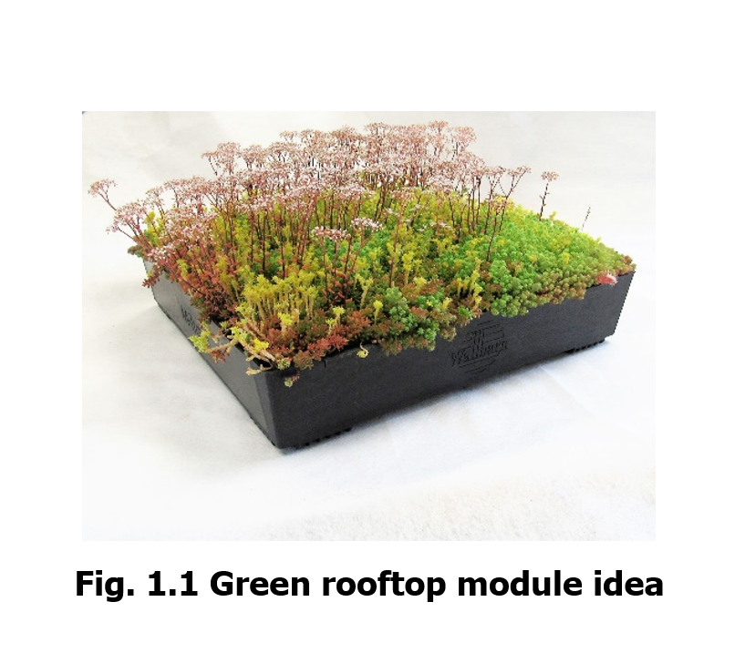
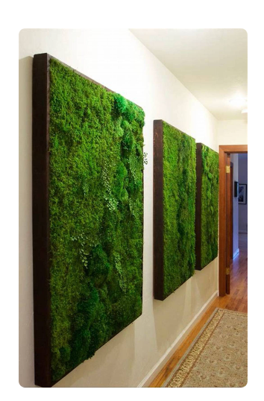
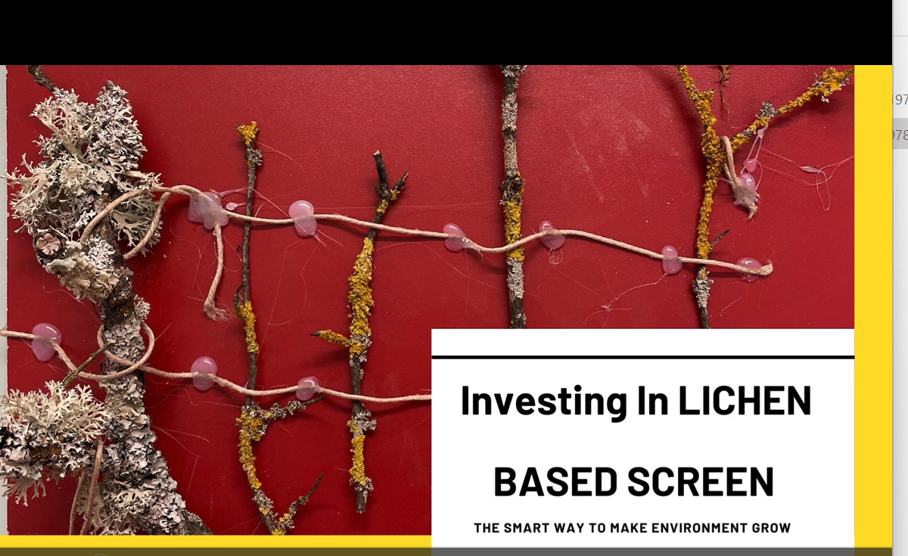
Compared to the innovations created by the first promotion of Citeuropass
Modular moss walls
Notes:
Here, is the slide in which we can compare two types of product in regard of the selected company before. Here are products which have no clients to start. The customers never used this type of product and these products have no brand.

Slide 7
Green rooftop modules : 3 types of information
Green rooftop modules are a key asset in urban ecology, providing solutions to challenges posed by urbanization. This overview delves into their ecological impacts, emphasizing their role in fostering biodiversity, alleviating the urban heat island effect, enhancing air quality, and managing stormwater runoff.
Green rooftops excel in promoting urban biodiversity, creating habitats for various species. They also combat the urban heat island effect by reducing surface temperatures, improving overall urban climate resilience.
These modules act as natural air purifiers, capturing pollutants and dust particles, and contribute to sustainable water practices by managing stormwater runoff.
Description / features of the market
Added value of the solution : arguments
Product presentation
Notes:
In this slide, I overview different : the added-value will be helpful to create arguments with terms of benefits. The description of the market focuses to highlight the trend of the demand. The product presentation will be helpful to explain in detail the product itself.

Slide 8
Investing in Lichen : Based Screen
An interactive screen that give you information on the quality of air in your rooms, your city changes color in response to the quality of the surrounding air, leveraging the unique properties of lichens.
Ecological Transition: Encourages community awareness and proactive behaviors towards cleaner air, aligning with ecological transition goals.
Biotechnology Integration: Incorporates biotechnology by using lichens as living bioindicators to assess and respond to air quality

Slide 9
Same questions than before
1. How to describe this company ?
2. What is your perception as client, as citizen, as business man/woman?
3. Would you like to buy one of the product of this Company ?
4. Would European clients be concerned by these products ?
(Ecommerce, shops…)
Brand, Customer Experience, Individual approach, Looking for customer’s satisfaction ?
How to start the activity ?

Slide 10
Question | Answers | Your Comments | Explanation : Brand, Product, Communication, Style, Sense ?
1 Description of this Company | Difficult to understand | What are they selling ? | New : there is no brand, no name of the product
2 Your perception as potential client ? | Care about environment, | Plant lover : so ok, interested | Green rooftops : ++
3. Would you like to buy one of the products ? | Yes, To pay for this ? | Price could be ? 50 euros/product | No price :
4. Would European clients be concerned by these products ? | Good solutions especially in the cities
Your comments

Slide 11
Who will buy these products : persona
To define your customers' most common needs, expectations and limitations.
Information are collected in a database
Location
Age
Life goals
How they appreciate an underwear ?
Experience
Level of education
Common complaints
Experience positive with an underwear, and a negative one
Income level
Interests
Where they hang out on internet (instagram, twitter, LinkedIn…)
Notes:
By knowing your target audience, you can create a better product for them.
During the research process, you need to analyze a number of factors
Two types of information : qualitative one and quantitative one
At the end, Experience that each of the client is living during the purchase

Slide 12
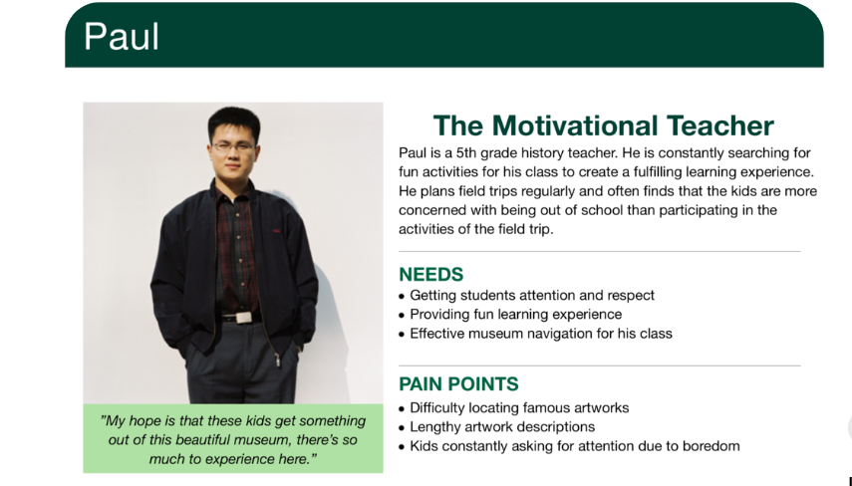
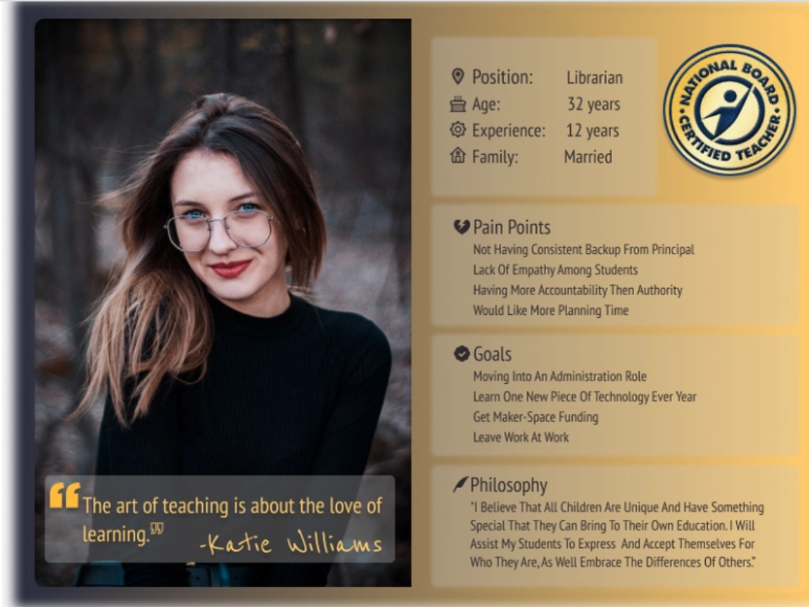
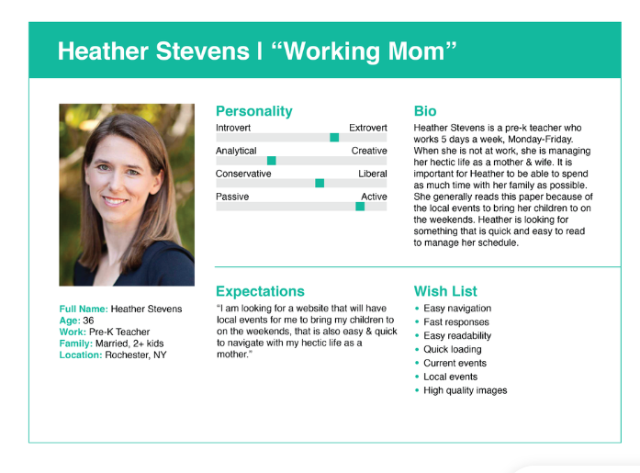
Notes:
3 different persona for one teacher pattern. Each of them are representative of a style of teaching but also a style of life. Individual stratefy of life

Slide 13
Who will buy these products ?: creation of persona
To define your customers' most common needs, expectations and limitations.
Information are collected in a database
Location
Life goals
How they appreciate to use this product ?
Age
Experience
Level of education
Common complaints
Experience positive with this product, and a negative one
Income level/awareness of the ecological topic
Interests
Where they hang out? (distributors, professional, internet)
Notes:
By knowing your target audience, you can create a better product for them.
During the research process, you need to analyze a number of factors
Two types of information : qualitative one and quantitative one
At the end, Experience that each of the client is living during the purchase

Slide 14
Difference between group and individual : 2 different approaches
Group :
Topic of the marketing, information are treated with statistic tools, we talk about average and difference to the average, promotion of the product to a maximum of potential customers « Push »
One person :
Unic, description of a behaviour in a context, values=attitude, make a decision : risk is present and need to be confident of this paiement.
Common issue : to understand the market and increase the sales
Notes:
To sell, a person will be unic . This is the big difference between a market approach and a commercial approach. And this difference is very impotant and explain why, most of the time, especially if the product is technic or difficult to understand easily, we need salesperson to explain .

Slide 15
In Europe ?
Group :
Markets can be decribed as very different
Culture, law can influence the access to the market
Language as a barrier
Price can be different
Brand is important
One Person
There is not so much difference due to the country and language
Experience : emotion, attitude and behaviour
Confidence in a Brand, Trust in the Product
Can buy more than one product, a solution

Slide 16
In Europe ?
Group : Focused on products
Markets can be decribed as very different
Culture, law can influence the access to the market
Language as a barrier
Price can be different
Brand is important
One Person : Focused on the satisfaction to change/to use
There is not so much difference due to the country and language
Experience : emotion, attitude and behaviour
Confidence in a Brand, Trust in the Product
Can buy more than one product, a solution

Slide 17
Portofolio of products oriented Clients
Le slip Français :
A large range of Products :
Underwear, socks, Pyjamas, Clothing, Footwear, Swimwear, Woman
Two main targets : Men and Women 80% of the turnover (men) and 20% (women)
Frugal innovations
Can these products be in the same range ?
Which one it the easier to explain ? To use ? To introduce ?
Clients targeted ?

Slide 18
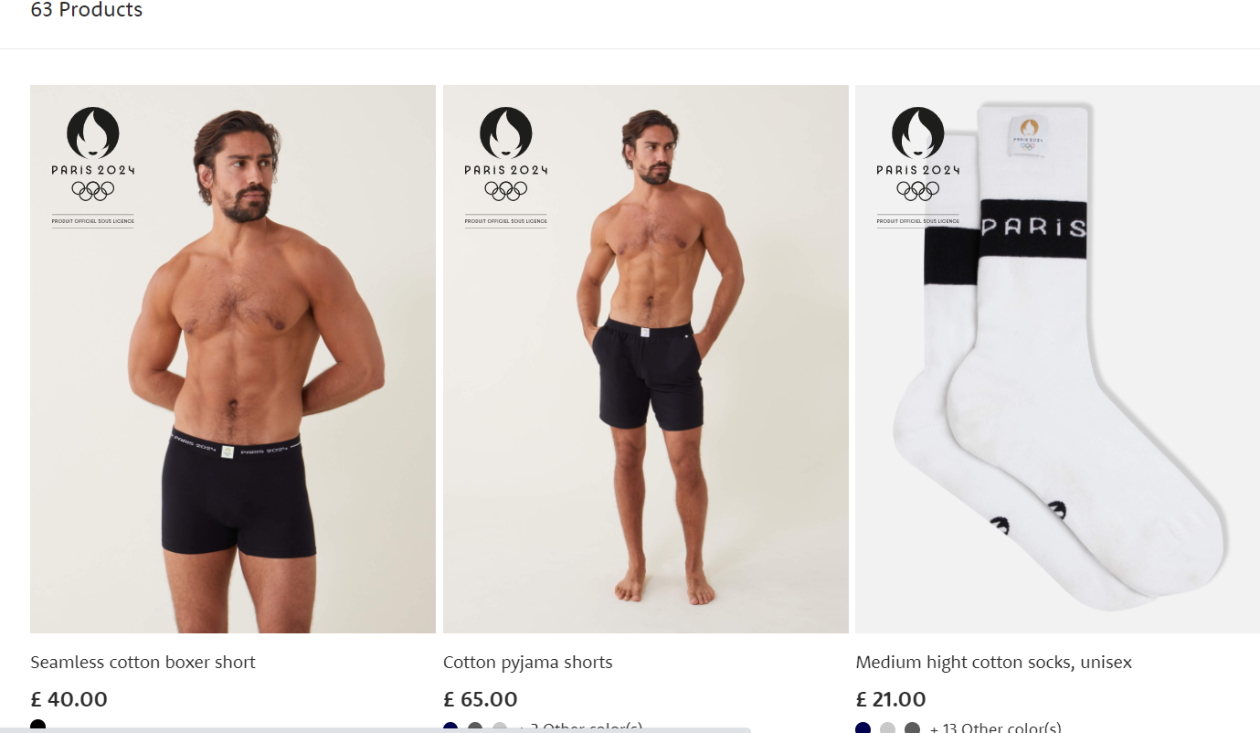
Products portofolio
The basic one : more than 70% of the demand
The original one : 25% of the demand (complementary selling)
The creative one : for event as Christmas (20% of the demand) : for the fun, to be different, to expose

Slide 19
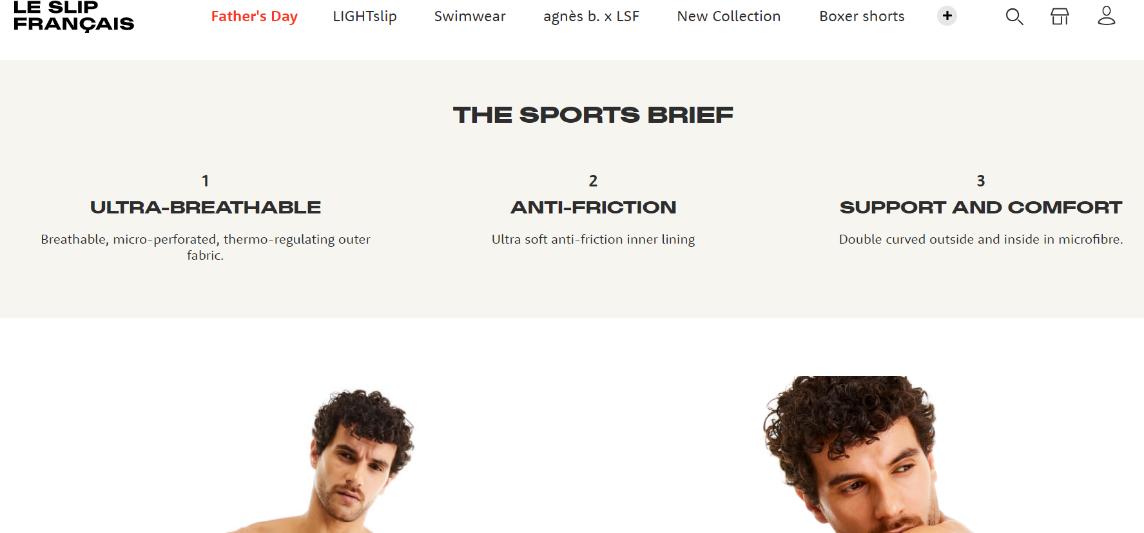
Benefit, Advantage, Caracteristic
CLIENT
PRODUCT
Notes:
Clients will pay for this product (high price on the market) not for the quality but for one or two of these benefits
The proof of this benefit is due to the caracteristic of the material used for the production
And the advantage of the product (to fight against competitors on the market) are advantages.

Slide 20
Innovative products | Caracteristics/Advantages of the product | Benefits of the product | Suggestions for changes
Green Rooftop Module

Slide 21
Why do we pay for the benefit and not the product ?
It is due to the risk perception and the consequences of taking this risk
Risk perception
Risk and the history of the management of the risk
Risk and the consequences of the risk
Risk and the decision
Two main actors to manage the risk : Yourself and The Others : Alterity

Slide 22
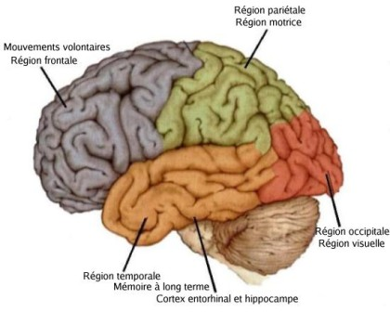
The brain as a main actor to manage the risk
Prefrontal Cortex : Premotor area
Vigilance organs : alterness
Parietal Region : motor cortex
Antorior cingulate cortex
Occipital Area :
Visual Cortex
Brain Stem: neuromodulation
Hippocampus and the long term memory
Notes:
Brain Stem : Tronc cérébral
Due to the size of the pupils you can devine if someone will take a decision or not
Planum region : region temporale location for the neuromodulations (networks of neurons and hormonal signal)
Proximité de l’aire visuelle et de l’aire de la réaction : vient de l’histoire humaine pour une meilleure adaptation à son environnement

Slide 23
Action plan Decision variables Sensory perception
Brain stem : neuromodulation, noradrenaline
Vigilance organs : alterness
Prefrontal Cortex : Premotor area
Parietal Region : motor cortex
Antorior cingulate cortex
Occipital Area
Visual Cortex
Hippocampus and the long-term memory
Flow of information
Neuromodulation integrated with the time
Notes:
Due to the size of the pupils you can devine if someone will take a decision or not
Planum region : region temporale location for the neuromodulations (networks of neurons and hormonal signal)
Proximité de l’aire visuelle et de l’aire de la réaction : vient de l’histoire humaine pour une meilleure adaptation à son environnement
Articles in reference : M. McGinley and al, « waking state : rapid variations modulate neural and behavioral responses. Neuron, vol 87, pp 1143-1161, 2015 + J W De Gree and al, « decision-related pupil dilation reflects upcoming reflects upcoming choice and individual bias » PNAS, vol 111, pp E618-E625, 2014 + G. Aston-Jones and JD Cohen « an integrative theory of locus coreuleus-norepinephrine function : adaptive gain and optimal performance, Annual Review fo Neuroscience, vol 28, pp 403-450, 2005. in Cerveau and Psychologie, juillet-août 2018 n°101.

Slide 24
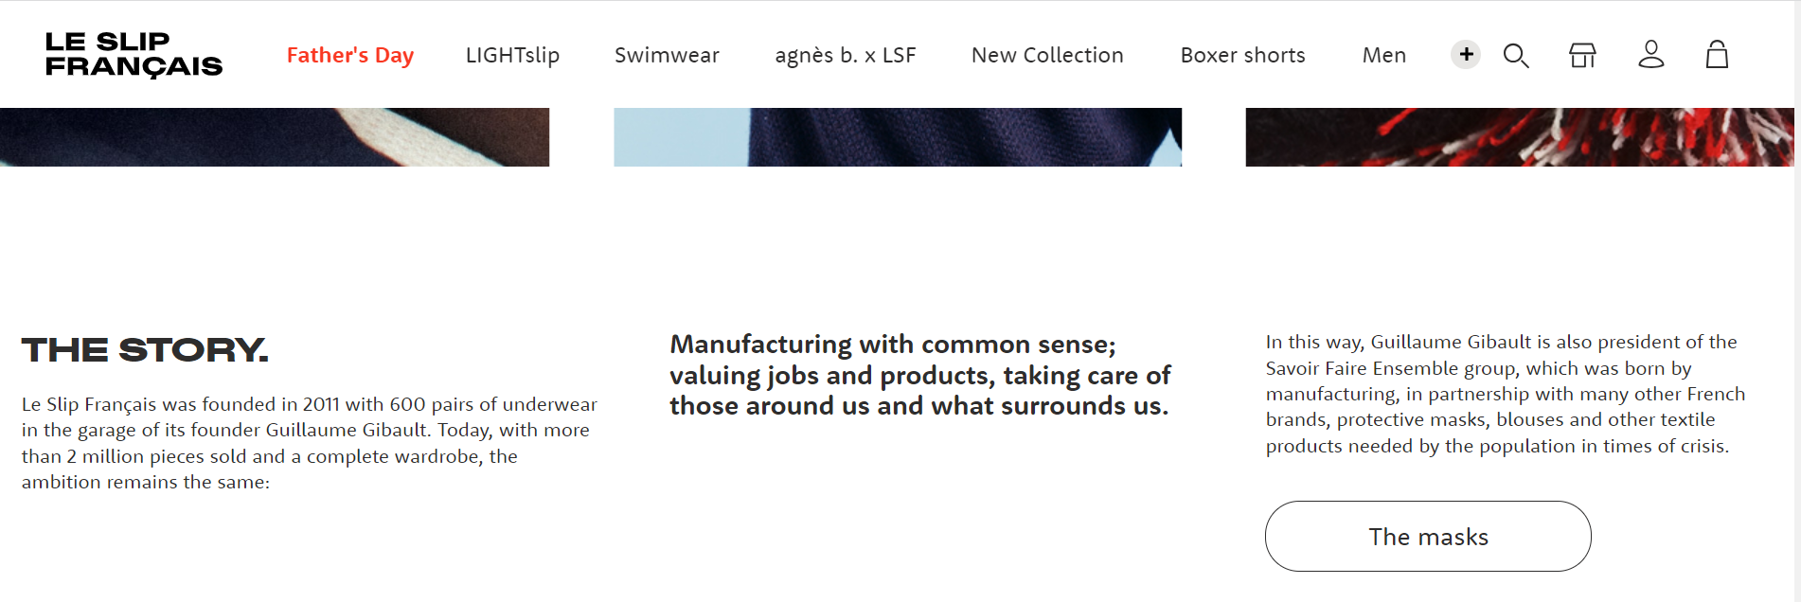
To be familiar : Storytelling of the Company

Slide 25


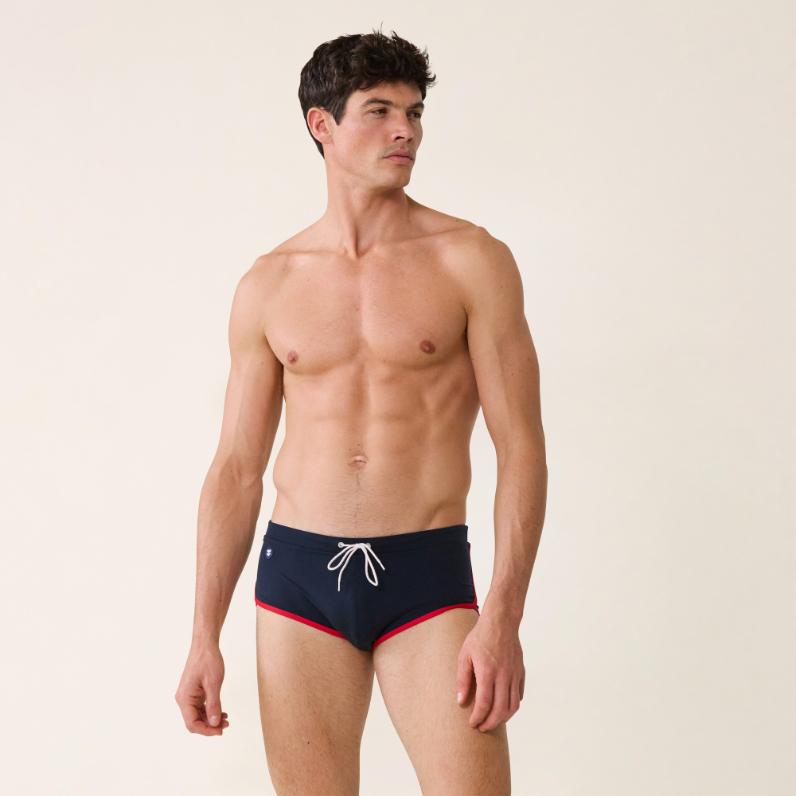

And also someone as a mirror : context
https://www.leslipfrancais.fr/waterslip-cesar-marine-slip-de-bain-de-sport-en-polyamide-16590.html
Notes:
With movment, movies are better to promote a product than only a picture and the picture has to show someone in life (movments)

Slide 26
To get the final choice, the client needs to compare
Each product has to find
An identity, personality
A name
In a family : other brothers and sisters ? (other products) : A range of product
Customers need to understand
Why this product makes sense
Why it is usefull to pay for this/these product : Added value of the solution
The risk he/her will take in buying/using this product
Comparison : to their usual solution, to the peers, to the history…

Slide 27

Your life refers to the consideration from Other and Other’s life refers to your consideration : « Human relationship »
Alterity

Slide 28
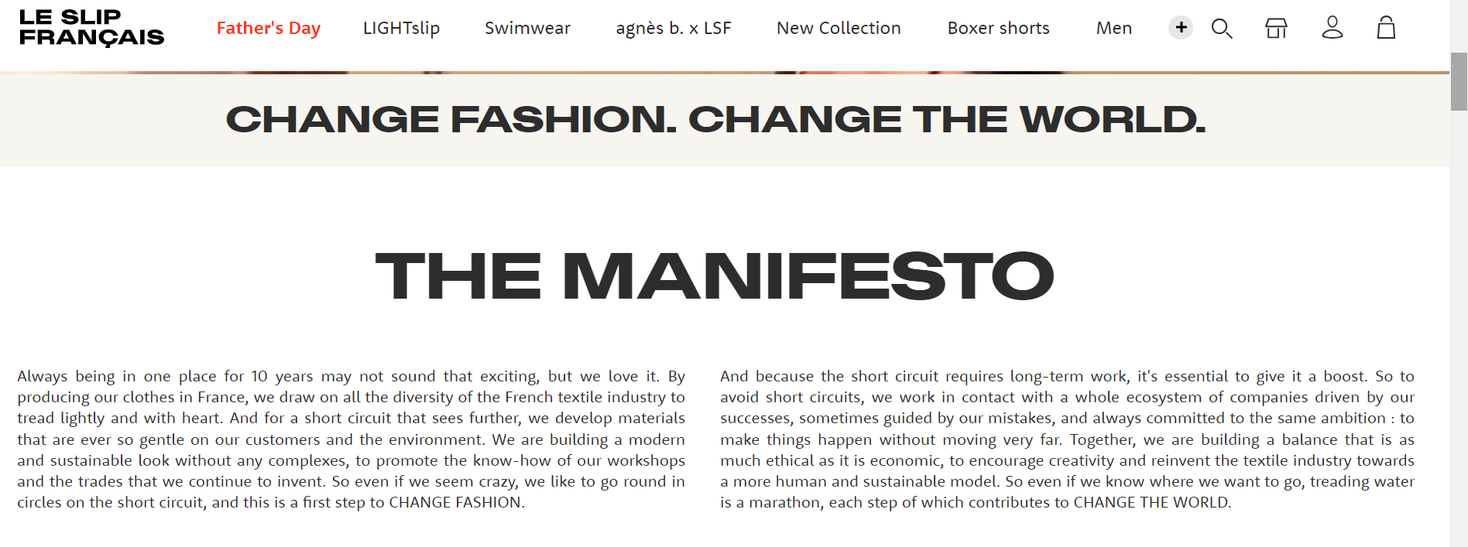
Engagement and Citizenship: Alterity

Slide 29
To sell to someone : A huge experience of alterity
Step 1 : get contact (to avoid the fear of new situation)
Step 2 : Discuss with (to know more and understand another point of view)
Step 3 : Offer your solution (linking with step2 and step 1) : Benefit
Step 4 : Answer to the limits (personalization of the solution)
Step 5 : Conclusion (payment and delivery)
Step 6 : Future

Slide 30
To sell to someone : A huge experience of alterity
Step 1 : get contact (to avoid the fear of new situation)
Step 2 : Discuss with (to know more and understand another point of view)
Step 3 : Offer your solution (linking with step2 and step 1) : Benefit
Step 4 : Answer to the limits (personalization of the solution)
Step 5 : Conclusion (payment and delivery)
Step 6 : Future

Slide 31




Step ?
Step ?
Step ?
Step ?
After this experience

Slide 32
Life is a daily risk = Everywhere in the world
Conclusion
We can sell to all the humanity
One person= One unic specificity
A group of person = an error
Context makes the difference : Language, culture, history, law, political actions
But we need to get a volume of clients to generate turnover and margin at the end.

Slide 33
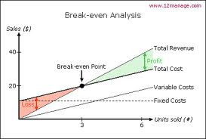
Break-even point is the key factor for your business

Slide 34
Europe and Trade
The EU has always been in favour of an open and fair international trading system.
The European Union, China (18% together) and the United States are the world's three largest economies 24% (2022)
The EU has played a central role in shaping the global trading system, through its support for the WTO.(world trade organization)
WTO : (1995 creation, 2022 European deals : Covid-19) has been created to encourage the trade agreements in the world :
GATT (General Agreement on Tariffs and Trade, 1947)
GATS for services
TRIPS for intellectual Properties
Notes:
WTO World Trade Organization : OMC : Organisation mondiale du commerce, GDP : PIB Produit Intérieur Brut
GATT (General Agreement on Tariffs and Trade, 1947 ( : Ensemble d’accords sur les tarifs douaniers et le commerce , 1947. GATS for the services and TRIPS (Trade related aspects of Intellectual Property Rights)

Slide 35
Europe = A large area for the negotiation skills
Europe invites the european actors to negotiate together : agreements

Slide 36
Which Business Model ?
How could we generate the turnover ?
Costs ?
Ecommerce/New shop/In a shop : Direct, Distributor ?
Guideline to promote a new solution to the market

Slide 37
Find a commercial issue to promote (To promote against diabetes diseases, to promote the treatment of the heart diseases, to promote the French products abroad in the instrumentation field….) .
Define the product or product range (price, distribution, features, communication…)
Carry out a commercial survey ( current markets, competitors, potential developments…)
The clients opinion (positive and negative, provided by the web, interviews (6 opened questions)…Collect all the stories of the products in their environments. List the opportunities and threats of this situation.
Imagine and write a story on these products in order to present them to people who do not know them from the experts to the layments.
Develop commercial arguments adapted to the level of the partners knowledge.
List the objections that your partners might raise (price, quality, difficulty of use, difficulty to understand, delay and inhibitions to purchase…)
List the different actors in the procurement process (prescriptors, opinion leaders, purchasing, users, end users, decision makers…)
your offer and arguments presented to your potential customers. Their opinions will help you to test it.

Slide 38
Set the tools which could be required for a succesfull
Communication guides : (all of them which will used for all the clients community, and these which will specific. (Main message, added value of your solutions, the way to the sales.
Define the activities required in a project of the combined tasks straight to a successful organization (priorities, beginning and the end each activity and assessment of your activities. Gantt project software
Assess your offer and arguments presented to your potential customers. Their opinions will help you to test it.
Generate leads and qualify them. (Company, Name, Surname, Phone, Email address, recommendations, actions for the future…)
Assessment of the commercial feed-backs
Adapt your action plan for the next steps of your commercial activities.
Recommandations for the future

Slide 39
During the conception of your solution, please try to answer to the questions here below
Innovative products and Europe ? | Central product | Product with feature | Product with service
Brand ?
Product ?
Price ?
Arguments ?
Targeted customers ?
Ecommerce ?
Distributors ?
Shops ?
Location ?
Experience ?
Labels ?
Law ?
…

Slide 40
Description of your Customer Journey Map: Road for a customer to decide to buy your product
 | Action 1 | Action 2 | Action 3 | Action 4 | Action 5
Thinking
Feeling
Pain points
Sentiment
Improvements

Slide 41
Thank you for your attention
See you during the innovative days in Grenoble !
I am available if you need help
Ghislaine.pellat@univ-grenoble-alpes.fr

