Slide 1


Managing people in Europe
Anna Vallušová, PhD.
Matej Bel University in Banská Bystrica, Slovakia
© 2025 by A. Vallusova is licenced under CC BY
Notes:
Instructor Notes
Highlight how Europe’s demographic structure, labour mobility, and cultural diversity create unique management challenges.
Present the session’s purpose: to explore what efficiency means for individuals, teams, and organisations — and how to improve it in practice.
Mention that efficiency is not about working harder, but working deliberately.

Slide 2
Efficiency
Organisational
Team
Personal
Notes:
Instructor Notes
Introduce the three layers of efficiency as an interconnected system: Personal → Team → Organisational.
Stress that organisational efficiency cannot be improved without addressing personal habits and team dynamics.
Explain that each level has different levers:
Personal: habits, time use, focus, mindset
Team: communication, goal clarity, collaboration, roles
Organisational: systems, culture, HR strategies, structures
Mention that inefficiency at one level cascades through the others.

Slide 3
Personal efficiency
Notes:
Instructor notes
Interaction with students. The aim is to give students the opportunity to self-evaluate issues in their personal efficiency. Use slido.com or other tool and ask students to express their agreemenn with the following topics:
I leave things to the last minute.
I work on the highest priority tasks throughout the day.
On a weekly basis I set aside time for planning the following week.
I attend unproductive meetings.
I leave space in my schedule to deal with the unexpected.
I use goal setting to determine my most important activities.
I put off tasks that are difficult or I don't like.
I routinely protect time in advance for the most important things.
I feel that email overtakes my day.
I feel stressed and overcommitted because of all the things I need to do.
I often procrastinate.
Interruptions (email, facebook, visitors or telephone calls) continually disrupt my work day.

Slide 4
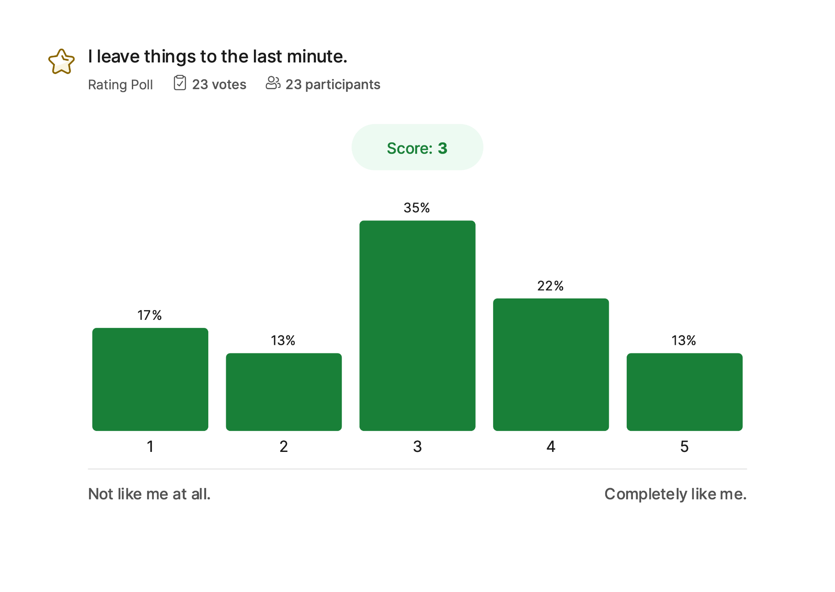
Notes:
Instructor notes
Show the results of the survey (in the slide, there are results of third Citeuropass wave)
Prompts for discussion:
What usually causes us to delay tasks? Is it lack of clarity, fear of difficulty, perfectionism, or simply habit? What strategies have helped you overcome last-minute rush

Slide 5
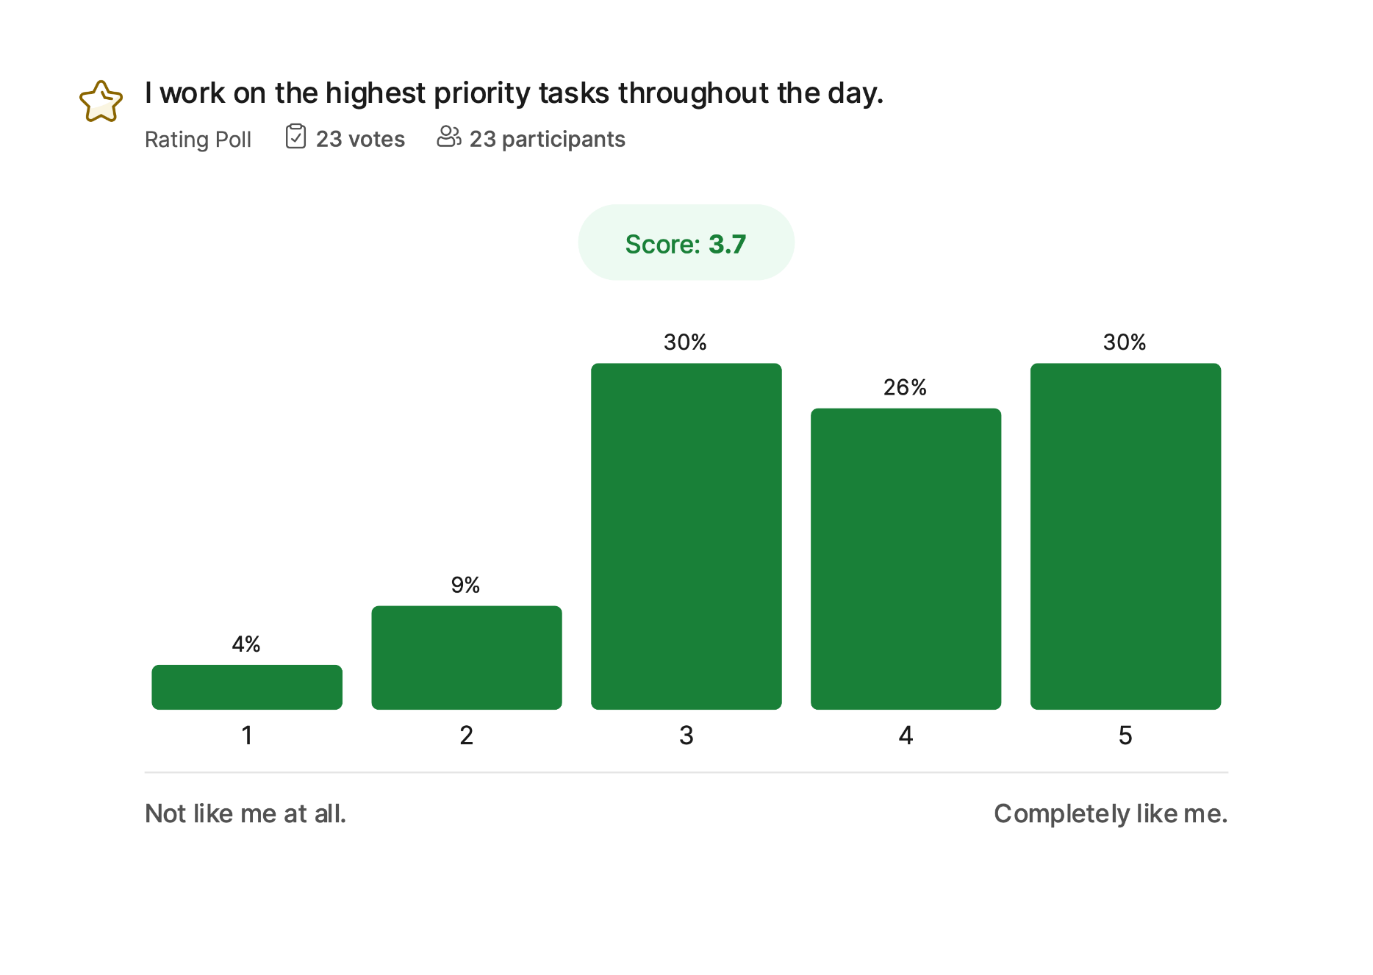
Notes:
Instructor notes
Show the results of the survey (in the slide, there are results of third Citeuropass wave)
Prompts for discussion:
What does ‘priority’ actually mean in your daily work? How do you decide what deserves your attention first? What gets in the way of maintaining this focus?

Slide 6
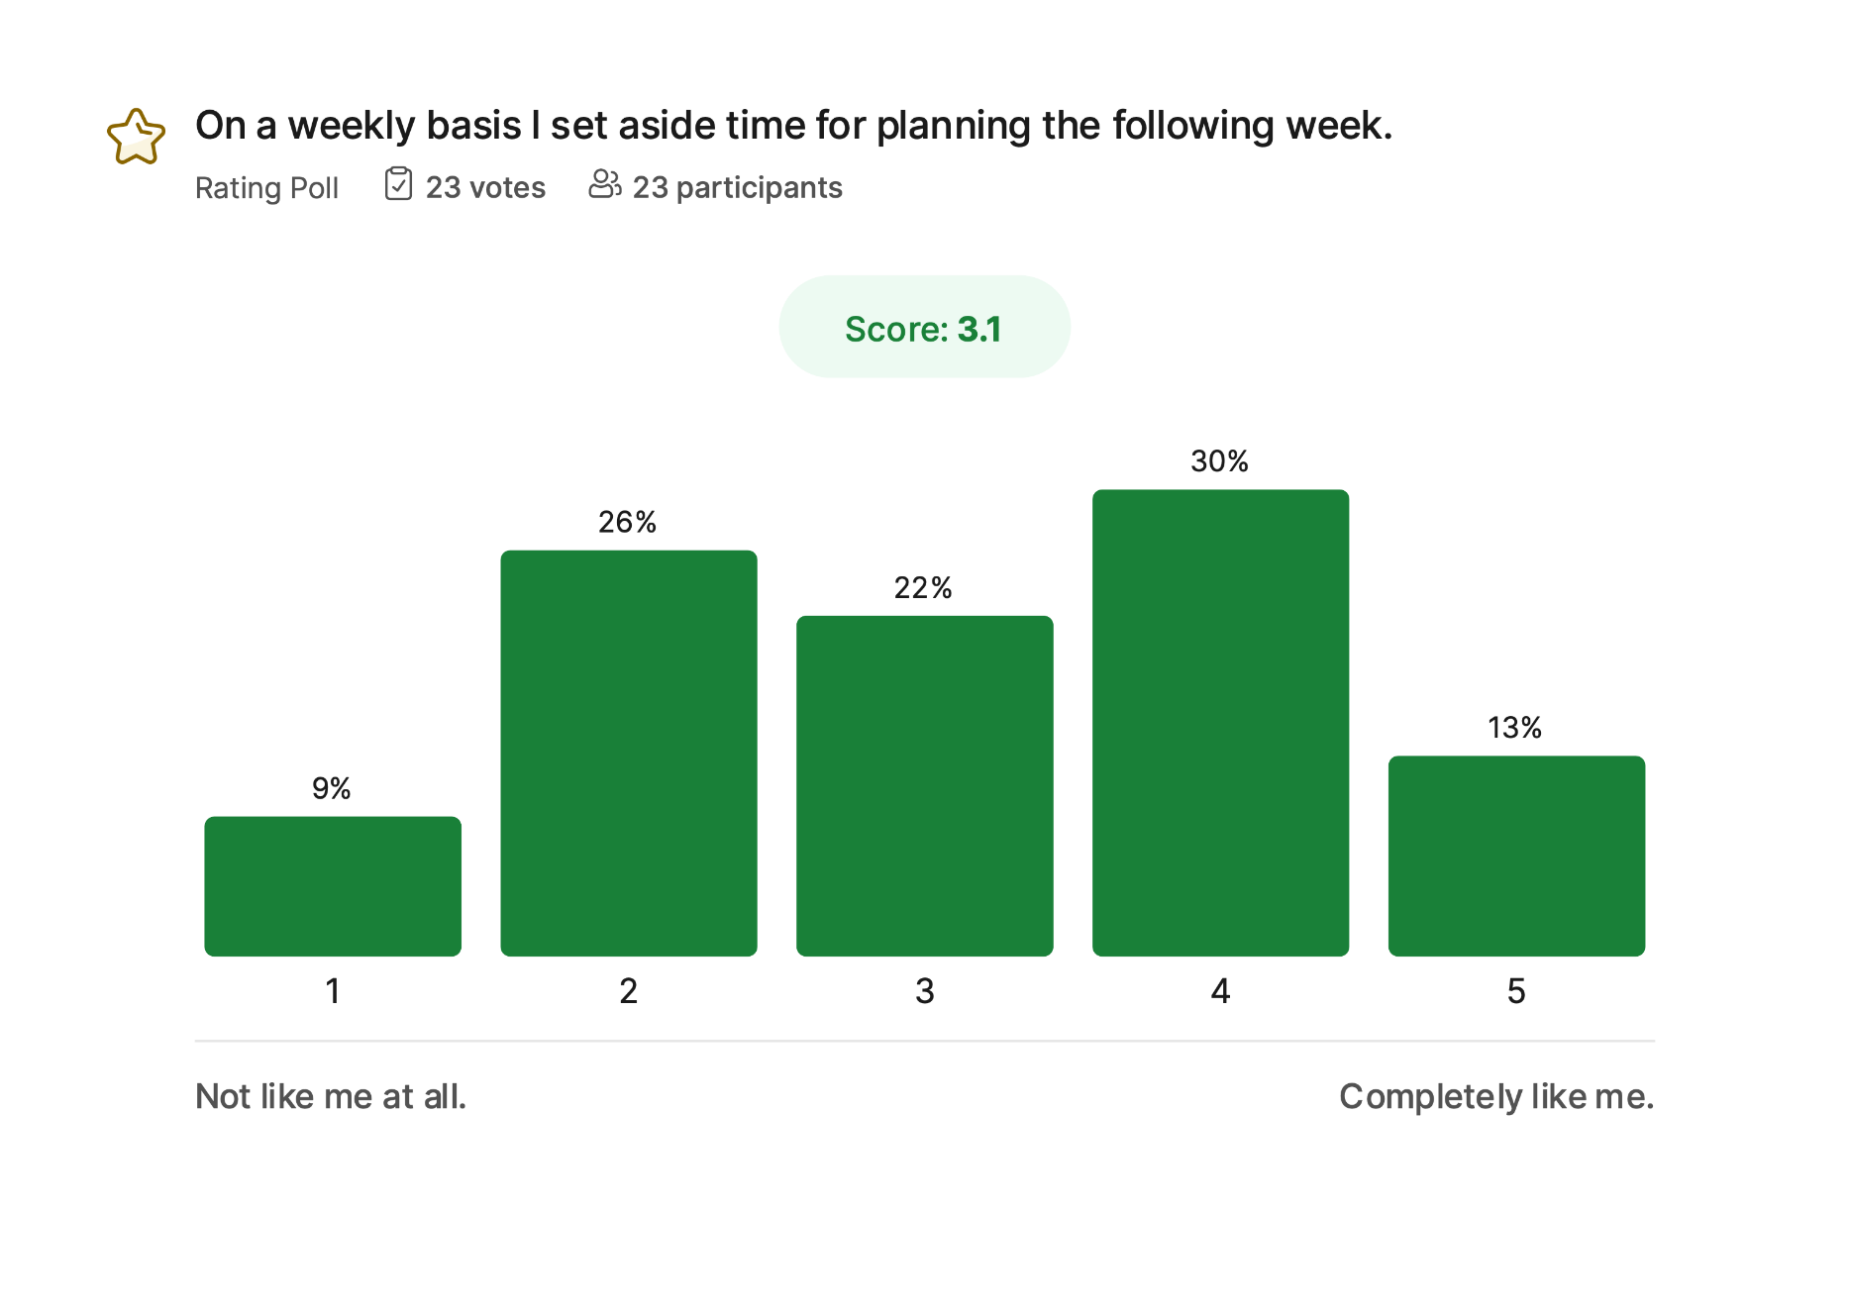
Notes:
Instructor notes
Show the results of the survey (in the slide, there are results of third Citeuropass wave)
Prompts for discussion:
What difference does weekly planning make in your productivity or stress levels? If you don’t do it, what stops you? What would be the smallest possible version of a weekly planning habit?

Slide 7
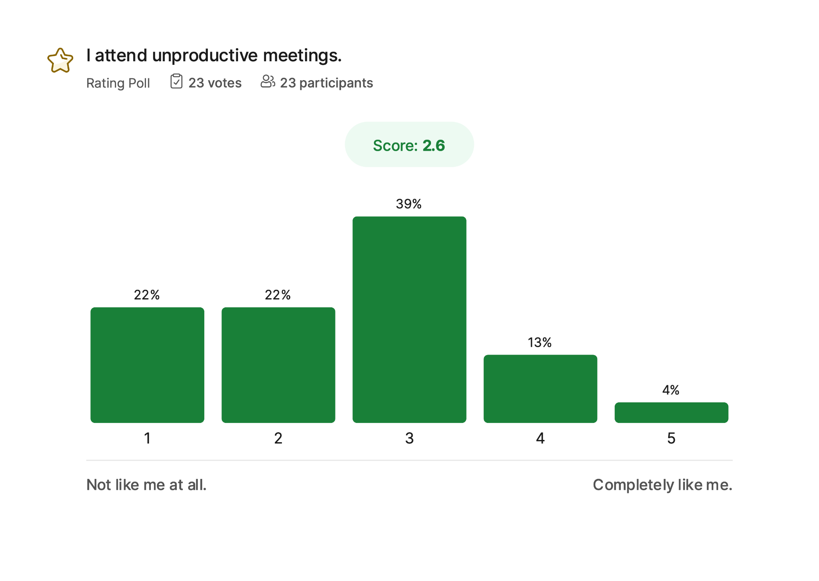
Notes:
Instructor notes
Show the results of the survey (in the slide, there are results of third Citeuropass wave)
Prompts for discussion:
What makes a meeting feel unproductive? What could you do — even if you're not the organizer — to increase the value of a meeting? When is it appropriate to decline a meeting?

Slide 8
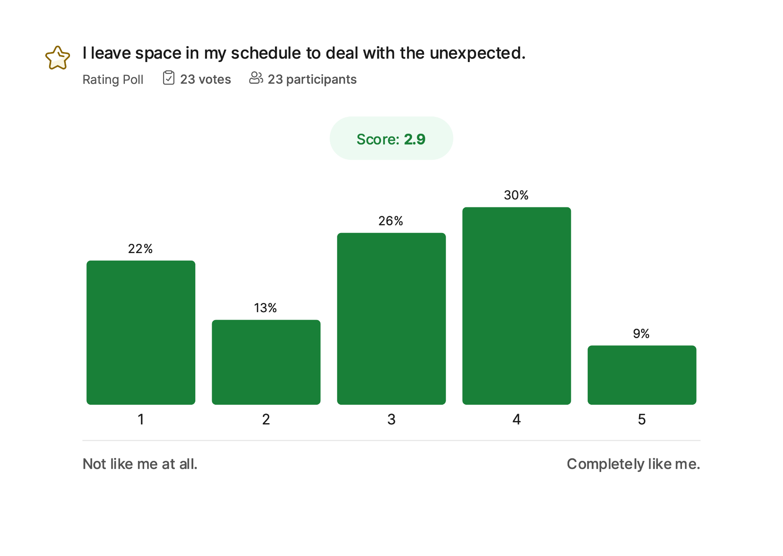
Notes:
Instructor notes
Show the results of the survey (in the slide, there are results of third Citeuropass wave)
Prompts for discussion:
How often do unexpected tasks or issues disrupt your day? What benefits might come from intentionally scheduling buffer time? Would this make you feel more or less in control?

Slide 9
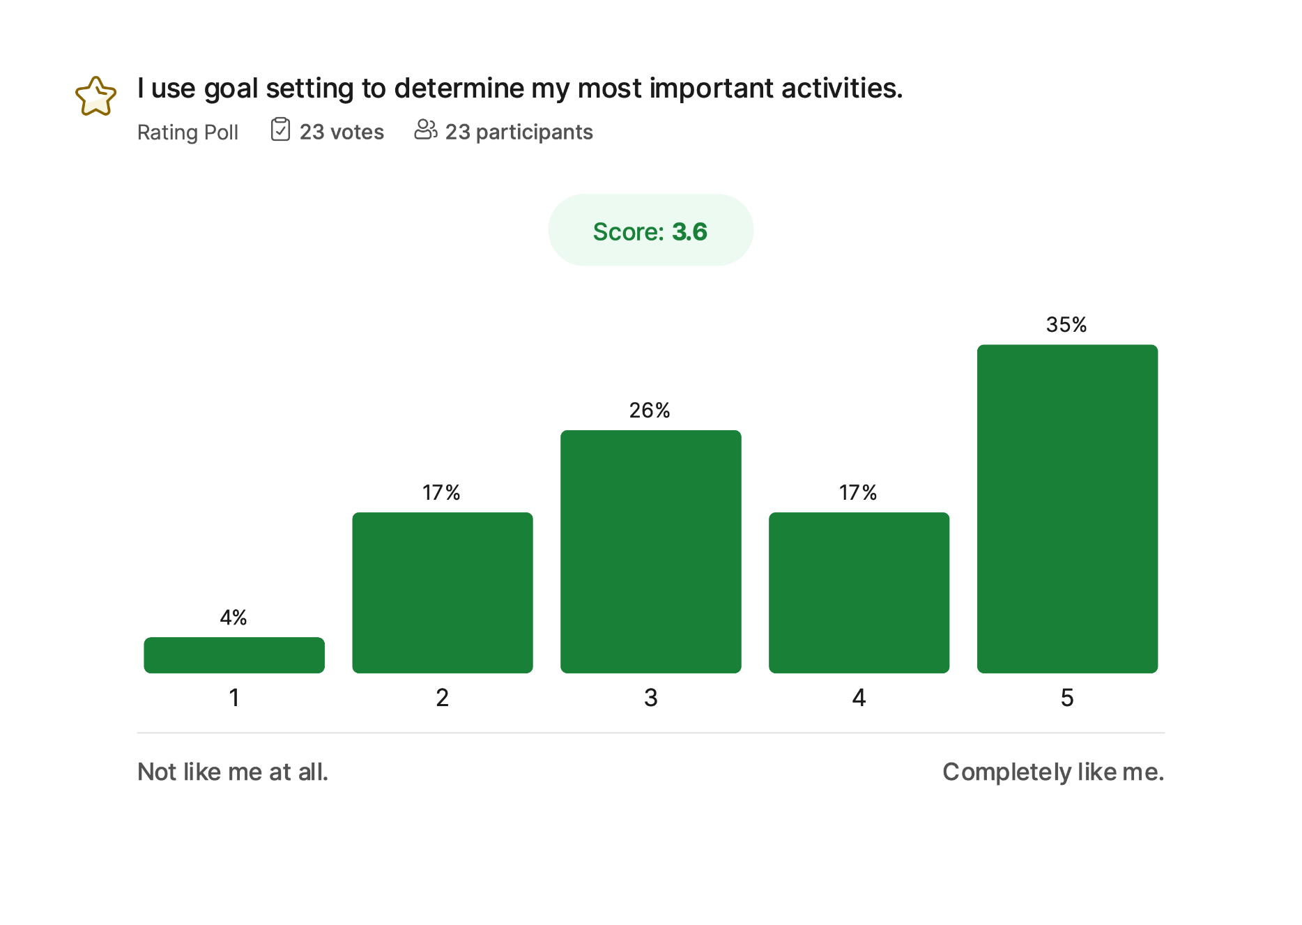
Notes:
Instructor notes
Show the results of the survey (in the slide, there are results of third Citeuropass wave)
Prompts for discussion:
How clear are your goals right now? How do they influence your day-to-day decisions? What happens when your tasks don’t seem aligned with your goals?

Slide 10
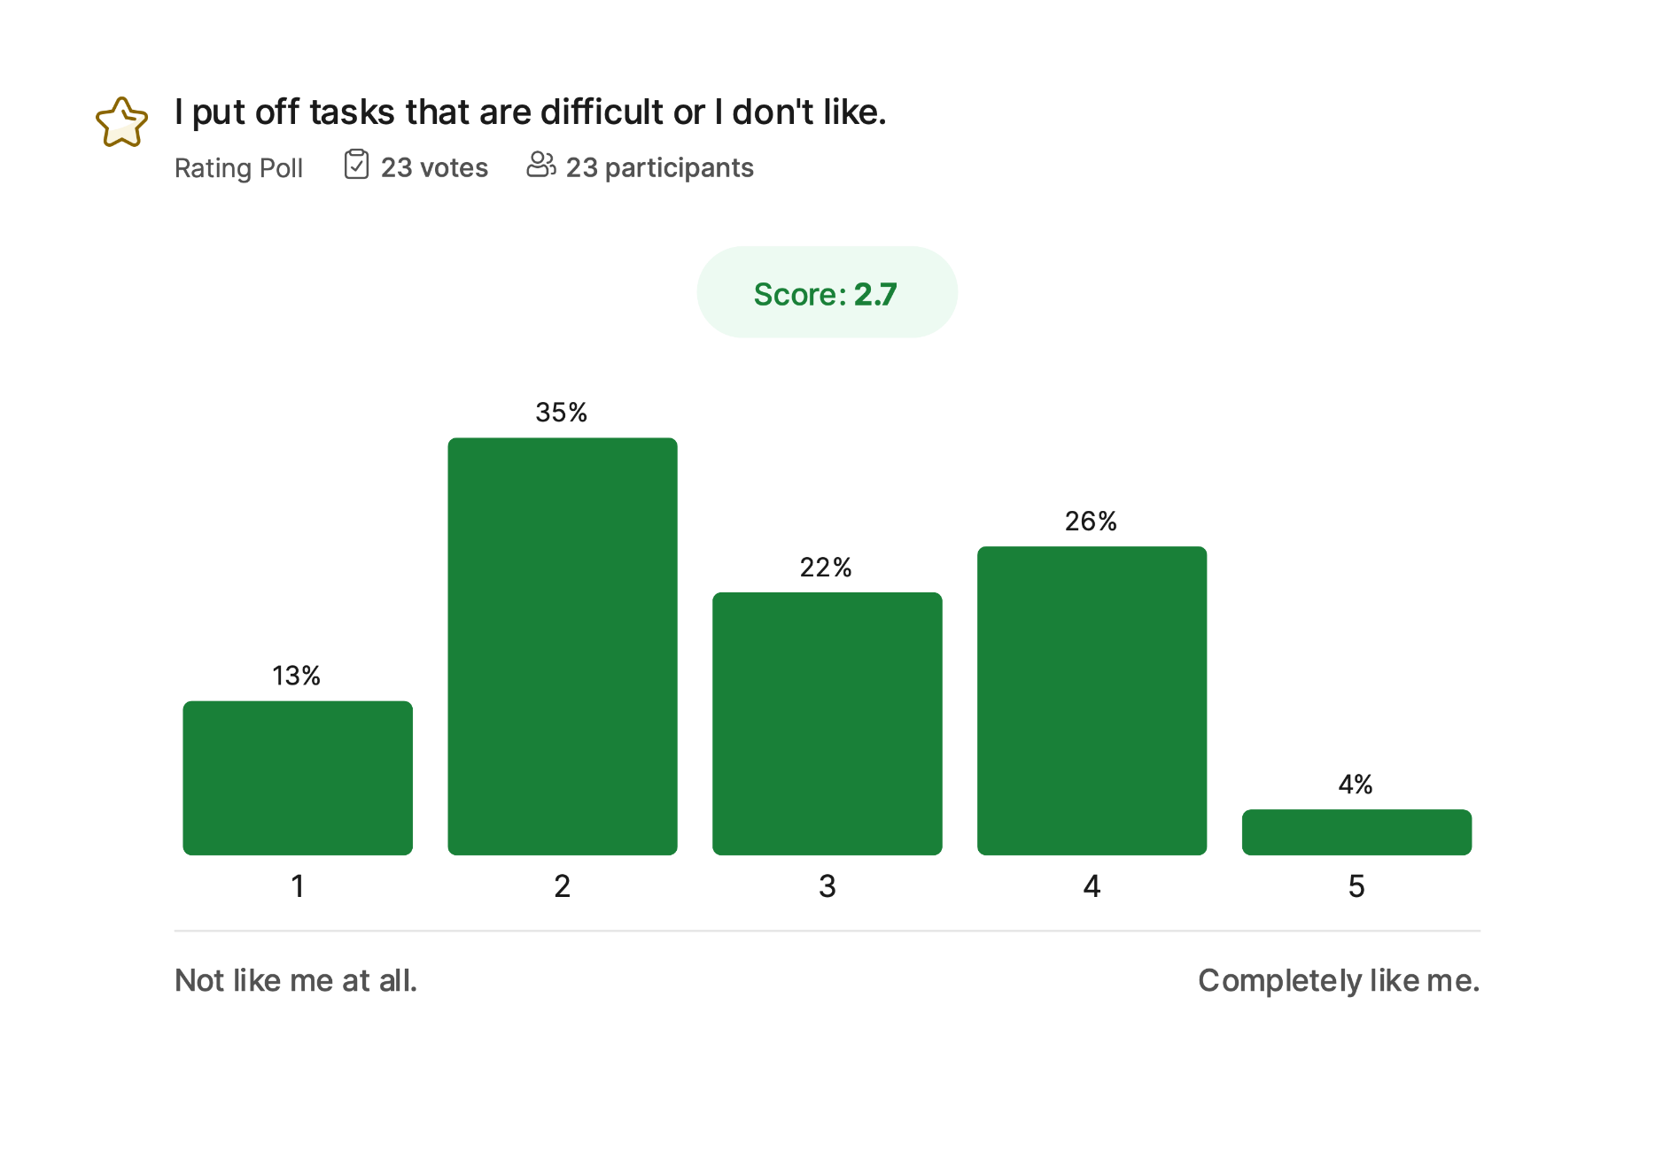
Notes:
Instructor notes
Show the results of the survey (in the slide, there are results of third Citeuropass wave)
Prompts for discussion:
What types of tasks are hardest for you to start? Why? What techniques help you begin something you normally avoid — breaking it down, setting a timer, pairing with someone, etc.?

Slide 11
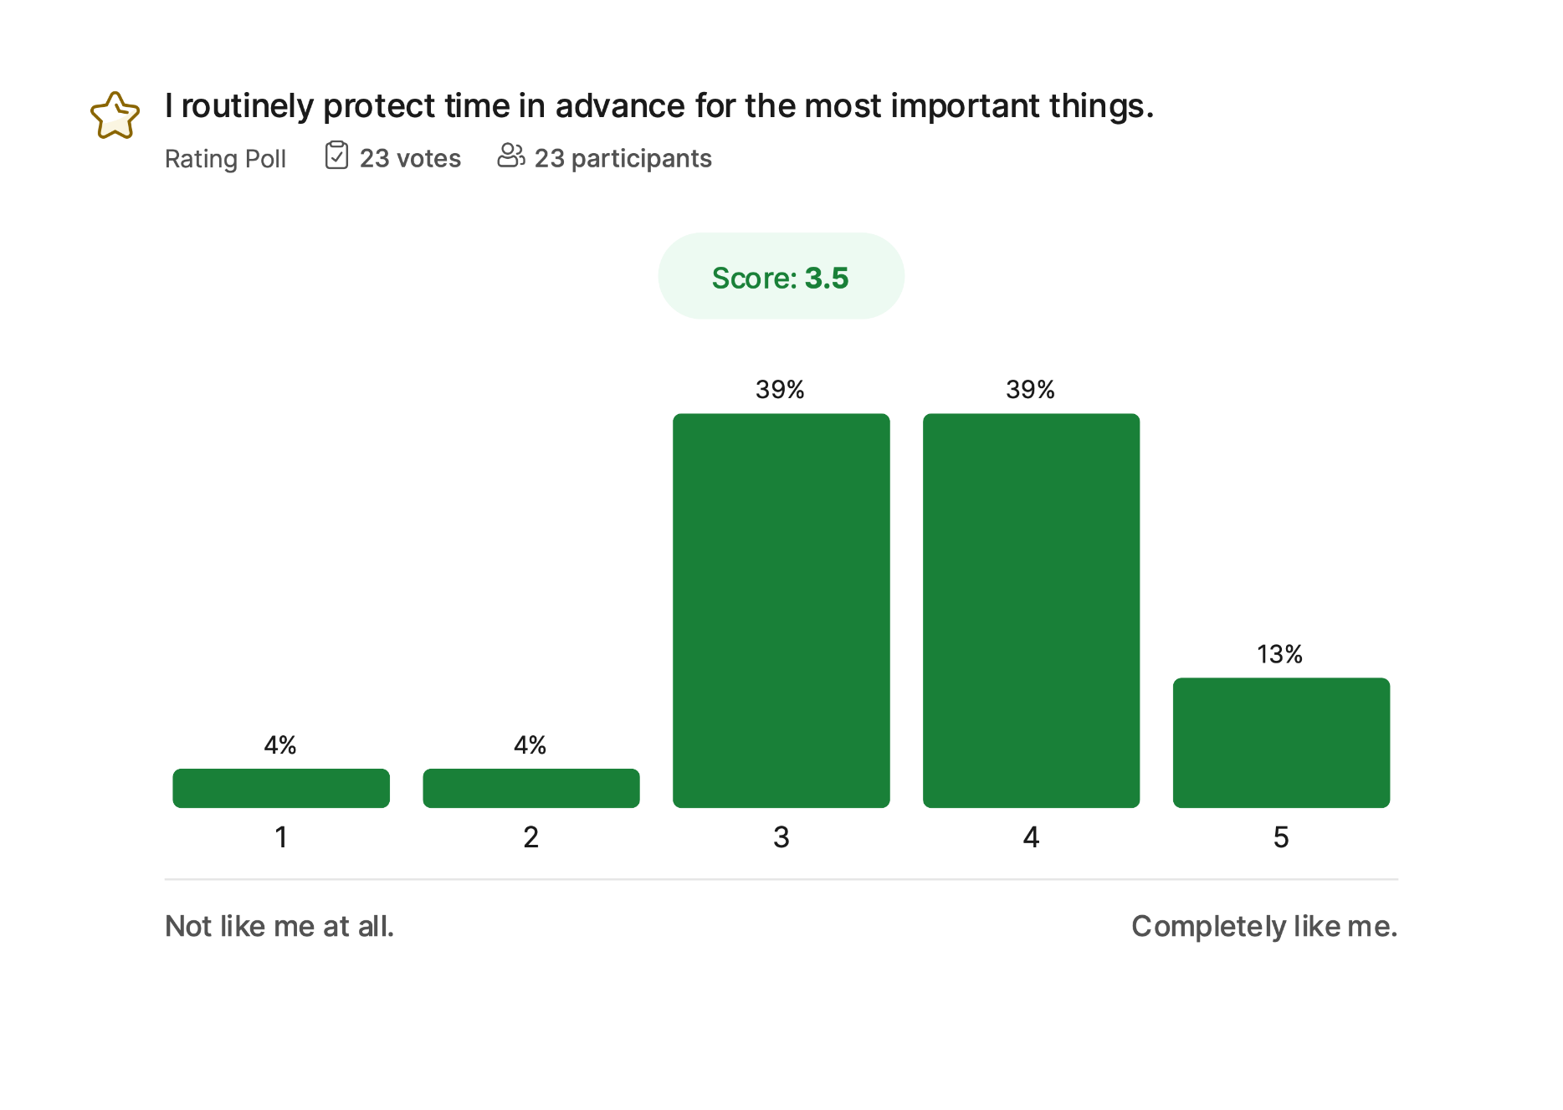
Notes:
Instructor notes
Show the results of the survey (in the slide, there are results of third Citeuropass wave)
Prompts for discussion:
How do you ensure that important tasks don’t get pushed aside by urgent ones? What tools or routines help you protect this time — calendar blocking, focus hours, saying no?

Slide 12
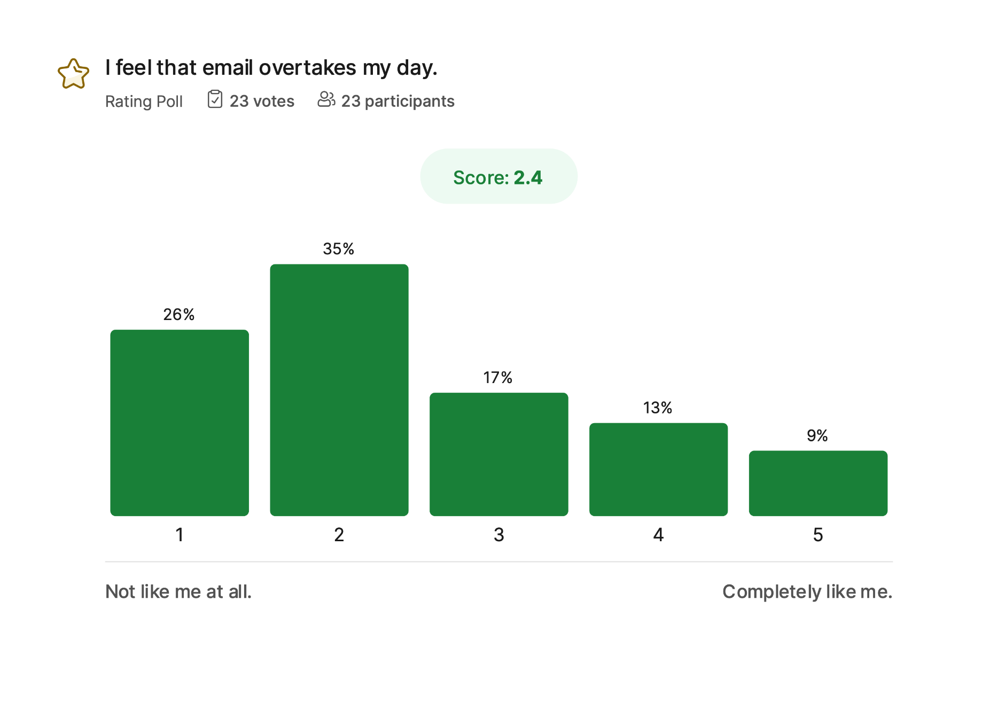
Notes:
Instructor notes
Show the results of the survey (in the slide, there are results of third Citeuropass wave)
Prompts for discussion:
Why does email feel so demanding? What patterns do you see in your own email habits? What boundaries or rules could reduce the sense of overwhelm?

Slide 13
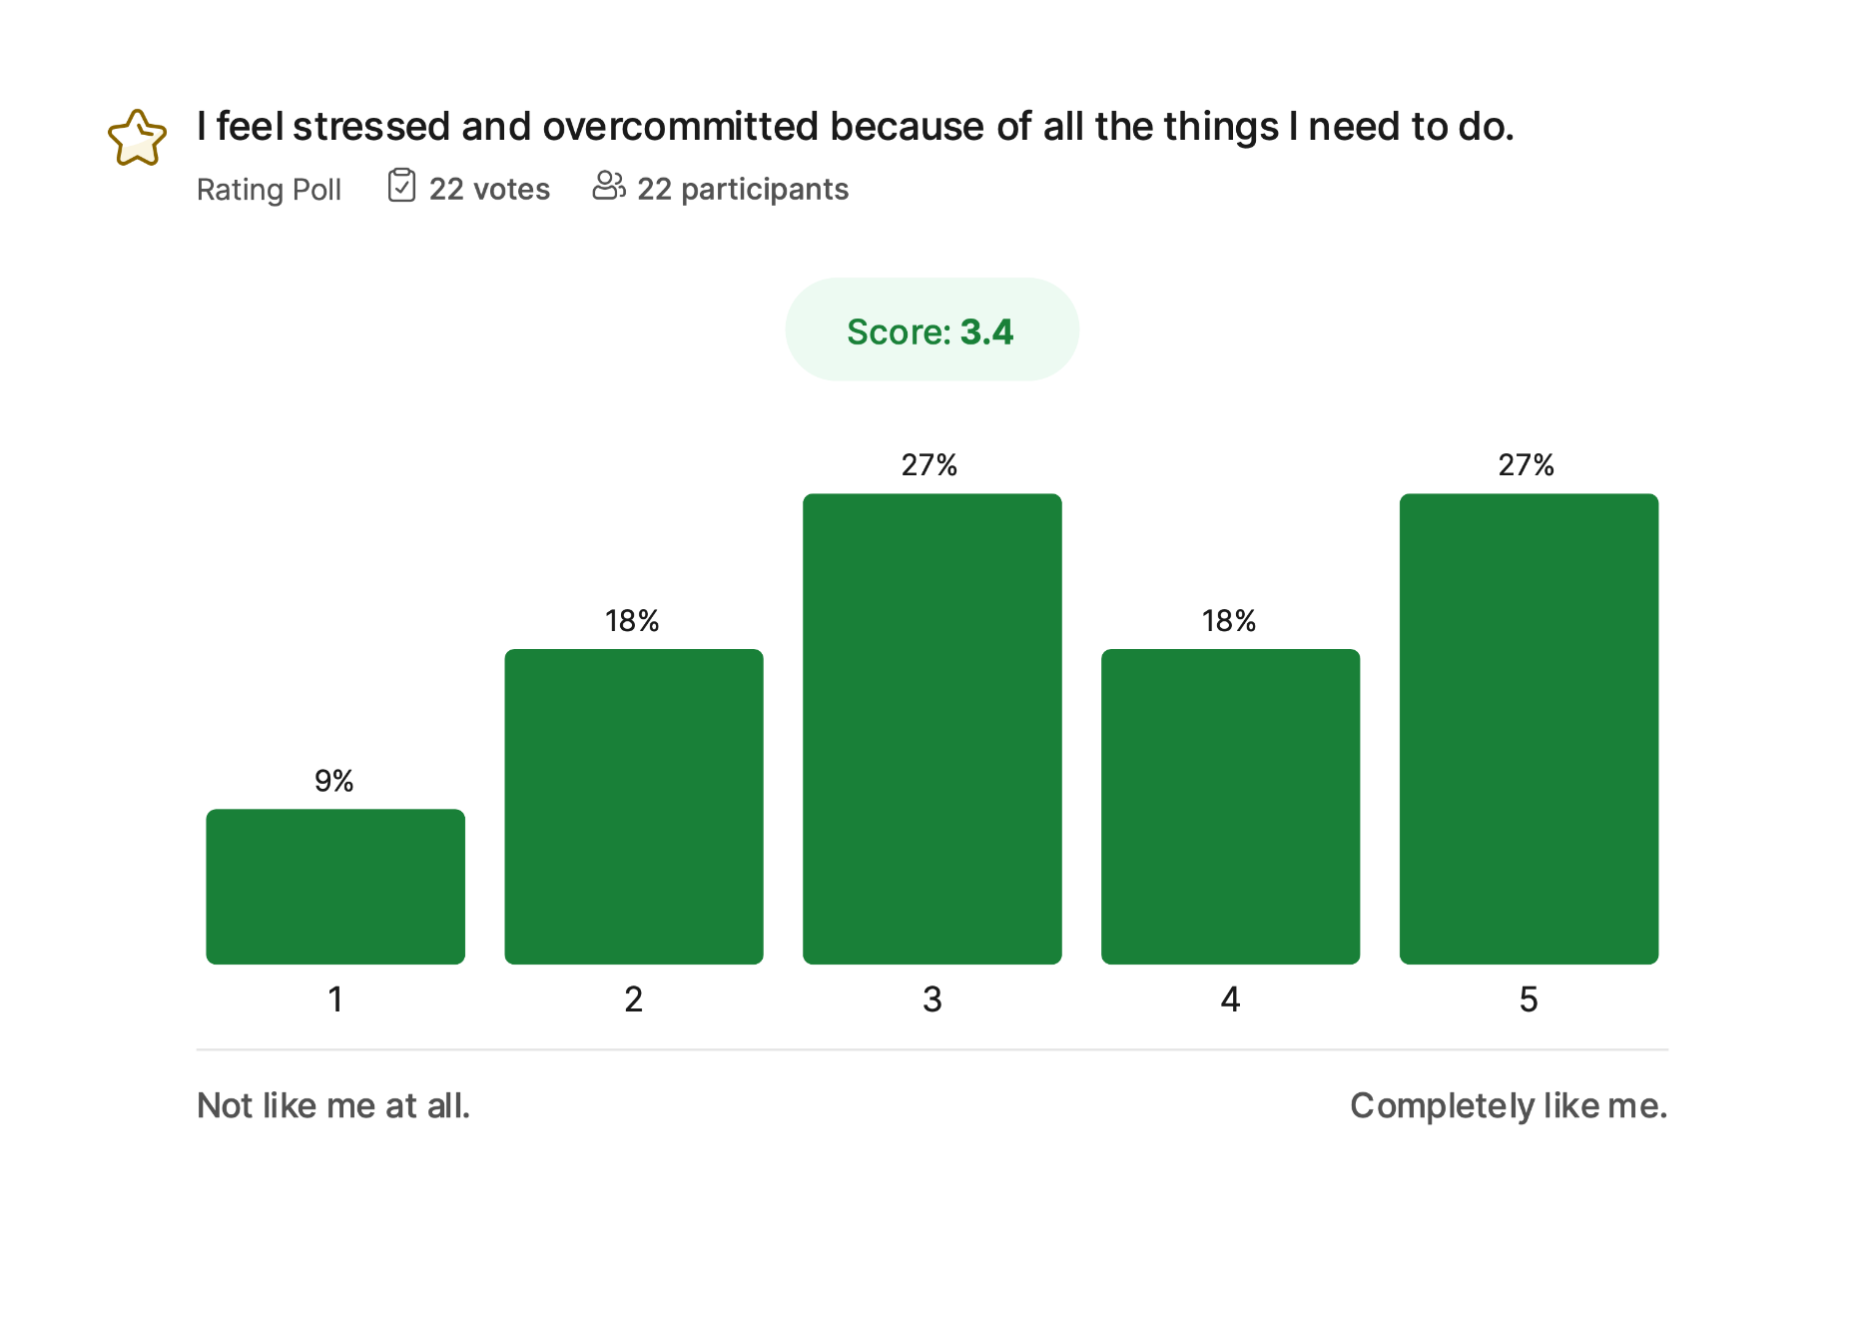
Notes:
Instructor notes
Show the results of the survey (in the slide, there are results of third Citeuropass wave)
Prompts for discussion:
What contributes most to this feeling — workload, expectations, unclear priorities, poor boundaries, or something else? What would lighten the load even slightly?

Slide 14
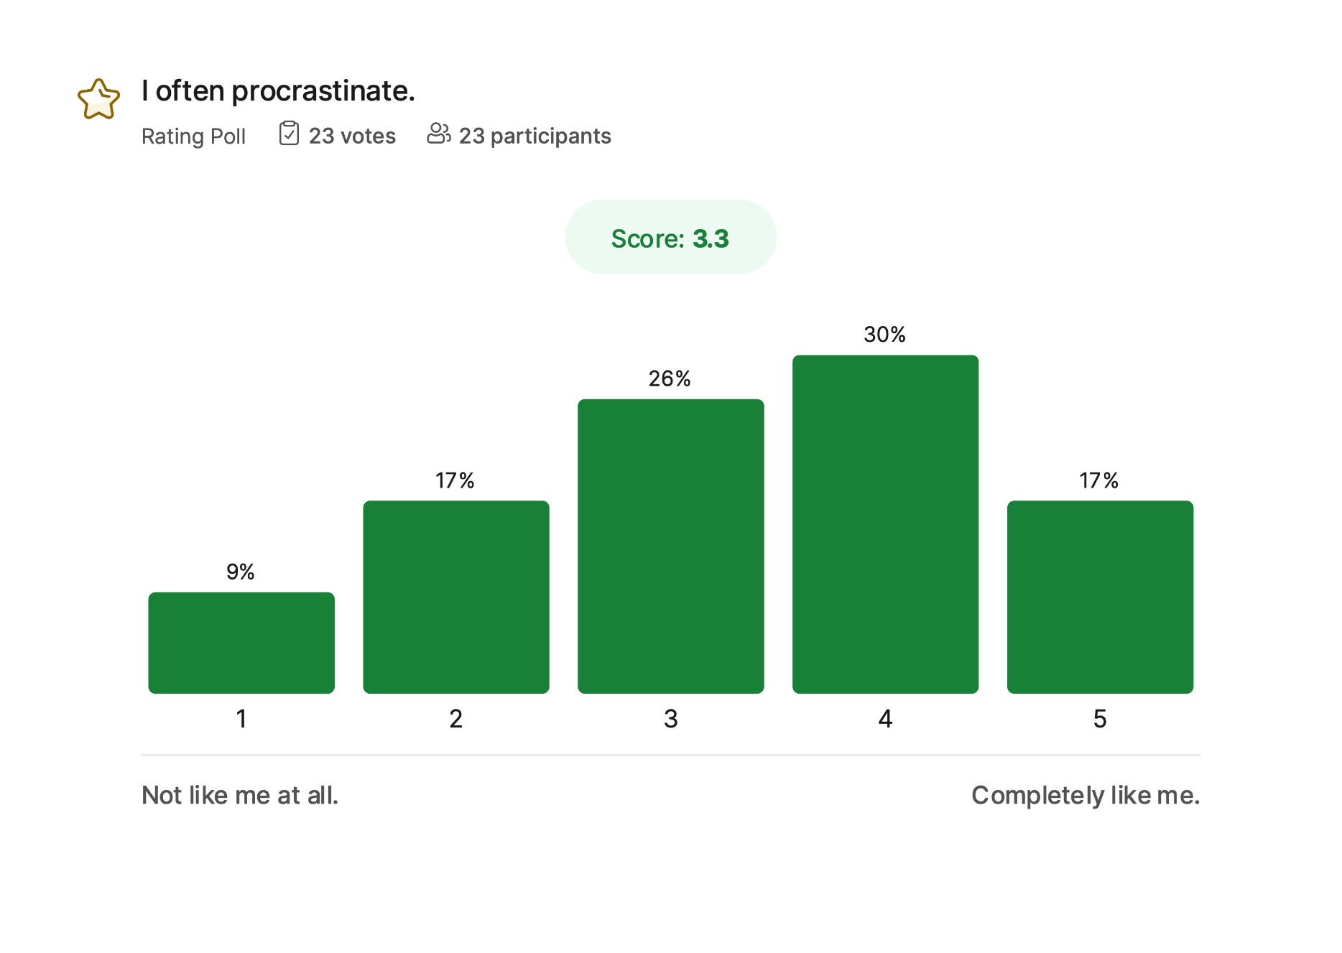
Notes:
Instructor notes
Show the results of the survey (in the slide, there are results of third Citeuropass wave)
Prompts for discussion:
What types of tasks trigger procrastination for you? What emotions or thoughts come with it — fear of failure, boredom, uncertainty? How can we design environments that reduce procrastination?

Slide 15
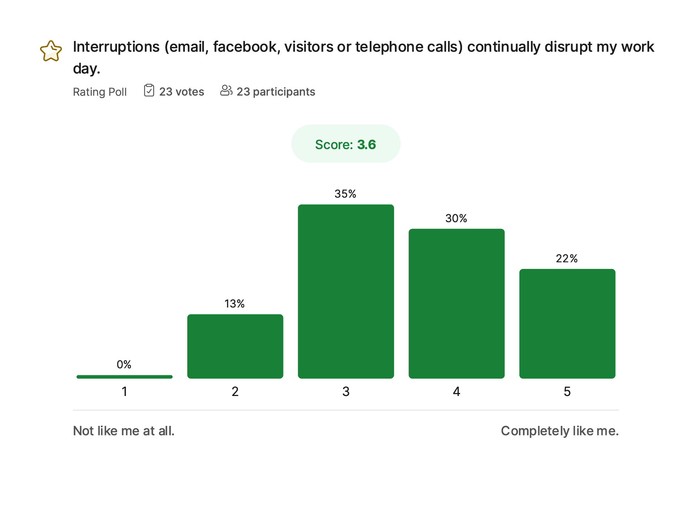
Notes:
Instructor notes
Show the results of the survey (in the slide, there are results of third Citeuropass wave)
Prompts for discussion:
What kinds of interruptions affect you the most? Which ones are within your control, and which are not? What strategies have you used (or could you use) to protect uninterrupted focus time?

Slide 16
Consideration 1– how do you spend your day?
1. record how you spend your day
2. evaluate it
3. identify possibilities for improvement
Notes:
Instructor Notes
Explain that most people have inaccurate ideas of where their time goes.
Describe a simple tracking method: record your activities for 2–3 days in 30-minute blocks.
Emphasize that the goal is awareness — not self-judgment.
Once recorded, evaluate:
Which activities support your goals?
Which drain time or energy?
Where are the “hidden” losses — context switching, interruptions?
Mention the Pareto principle: often 20% of activities produce 80% of results.

Slide 17
Consideration 2 – evaluation of the activities
Notes:
Instructor Notes
The Eisenhower Principle — named after U.S. President Dwight D. Eisenhower — is a time-management framework that helps people decide what to do, what to plan, what to delegate, and what to eliminate.
It is based on the idea that not all tasks are equal. Some demand immediate attention (urgent), while others contribute meaningfully to long-term goals (important).
To use the principle, tasks are placed in a 2×2 matrix:
A – Crisis, B efficiency, C- illusion, D- wasting
Walk through the logic of eliminating, delegating, standardizing, scheduling, and optimizing.
Explain that not all tasks deserve equal attention.
Use examples: e.g., repetitive tasks → templates; poorly done tasks → training or tools.

Slide 18
Step 2 – evaluation of the activities
Eliminate activities that are not necessary
Delegate activities that do not have to be done by you
Standardize activities that you do often
Schedule activities that are urgent
Optimize activities that you are not doing well
Notes:
Introduce the five strategic decisions: Eliminate – Delegate – Standardize – Schedule – Optimize.
Expand:
Eliminate: Some tasks simply don’t need doing; challenge assumptions.
Delegate: Delegation is a leadership skill; discuss barriers: trust, perfectionism, unclear instructions.
Standardize: Repeat tasks deserve templates and checklists.
Schedule: Put important tasks in the calendar; avoid “when I have time”.
Optimize: If something always takes too long, rethink the process or tool.
Provide examples: email templates, batching errands, shared documents.

Slide 19
Consideration 3 – Sense of agency
To which extent do I determine the way, how I am spending time?
To what extent is my control over the way how I am spending time limited?
What prevents me from taking the control over my time?
Notes:
Instructor Notes
Invite participants to think about internal vs. external control.
Discuss common blockers: interruptions, unclear expectations, people-pleasing.
Highlight that agency is learned, not given.

Slide 20
Consideration 4 – fluctuation of the performance over day
Get to know your natural rythm
Allocate important tasks to the productive time and routine tasks to the less productive time
Notes:
Instructor Notes
Explain chronotypes and natural rhythms.
Encourage scheduling high-focus tasks during peak energy and routine tasks during dips.
Mention that misalignment leads to burnout and inefficiency.

Slide 21
Considration 5 - Planning
Yealy
Monthly/Weekly
Daily
Events vs. tasks
Notes:
Clarify hierarchical planning: long-term direction → mid-term structure → daily execution.
Describe the difference between events (fixed) and tasks (flexible).
Recommend batching tasks and limiting daily goals.

Slide 22
Considaration 6 – eliminating of time thieves
lack of organization
postponing /procrastination
inability to say NO
indecision
ineffective communication
impatience + hurry
little/much information
Social networks
Emails
Notes:
Instructor Notes
Talk through typical “time thieves”: procrastination, overcommitment, digital distractions, poor communication.
Encourage concrete strategies: saying no, planning buffers, inbox management, reducing context switching.

Slide 23
Team efficiency
Notes:
Instructor Notes
Frame team efficiency as more than the sum of individual efficiency.
Invite participants to recall best and worst teams—they often hinge on communication, clarity, and trust.
Explain that many teams underperform due to structural, not personal, issues.
Slido interaction:
Invite students to fill in the following survey (open question)
Think about any team cooperation you have experienced. What factors make the cooperation frustrating?
Think about any team cooperation you have experienced. What factors make it sucesfull?

Slide 24
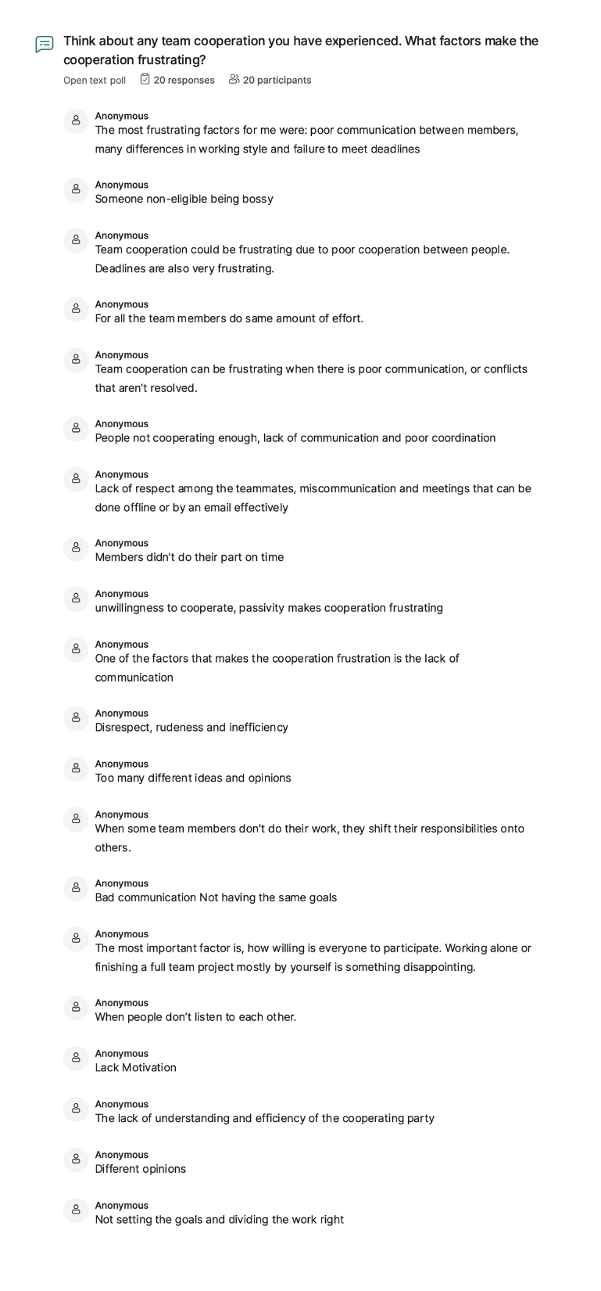
Notes:
Instructor notes
Invite the students to share the stories of team cooperation that went wrong.
Generate the list of barriers of team efficiency

Slide 25
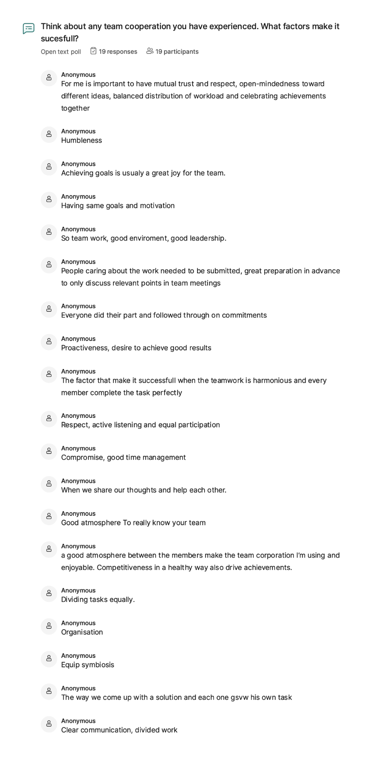
Notes:
Instructor notes
Invite the students to share the stories of team cooperation that was sucessful
Generate the list of prerequisites of team efficiency

Slide 26
Consideration 1 - Clear goals
Specific/Stretching
Measurable
Attainable
Relevant
Trackable/Timable
Notes:
Instructor Notes
Explain why teams need shared goals: alignment, motivation, conflict reduction.
Expand SMART criteria with examples:
Specific: “Improve customer satisfaction score by 10%.”
Stretching: Ambitious but achievable.
Measurable: Data or tangible indicators.
Attainable & Relevant: Within capacity and aligned with strategy.
Trackable / Time-bound: Milestones prevent drift.
Emphasize that teams must participate in defining goals for real commitment.

Slide 27
Consideration 2 -Clear communication
Seek First to Understand, Then to Be Understood
Efficient meeting + written record on what was agreed
Beware of the emails
Notes:
Instructor Notes
Introduce Stephen Covey’s principle: Seek first to understand, then to be understood.
Explain that communication quality directly impacts team efficiency.
Key practices:
structured meetings with agendas and clear outcomes
written summaries to avoid ambiguity
appropriate channel use (email vs. call vs. in-person)
Highlight email pitfalls: tone misunderstandings, long threads, delayed responses.

Slide 28
Consideration 3- Clear responsibilities
Think Win/Win
Synergy
Notes:
Instructor Notes
Explain how ambiguity causes duplication, conflict, and dropped tasks.
Introduce tools: RACI matrix, task ownership, role clarity.
Emphasize Win/Win thinking: collaboration rather than competition.
Describe synergy: combining different strengths yields better results than isolated work.

Slide 29
Organizational efficiency

Slide 30
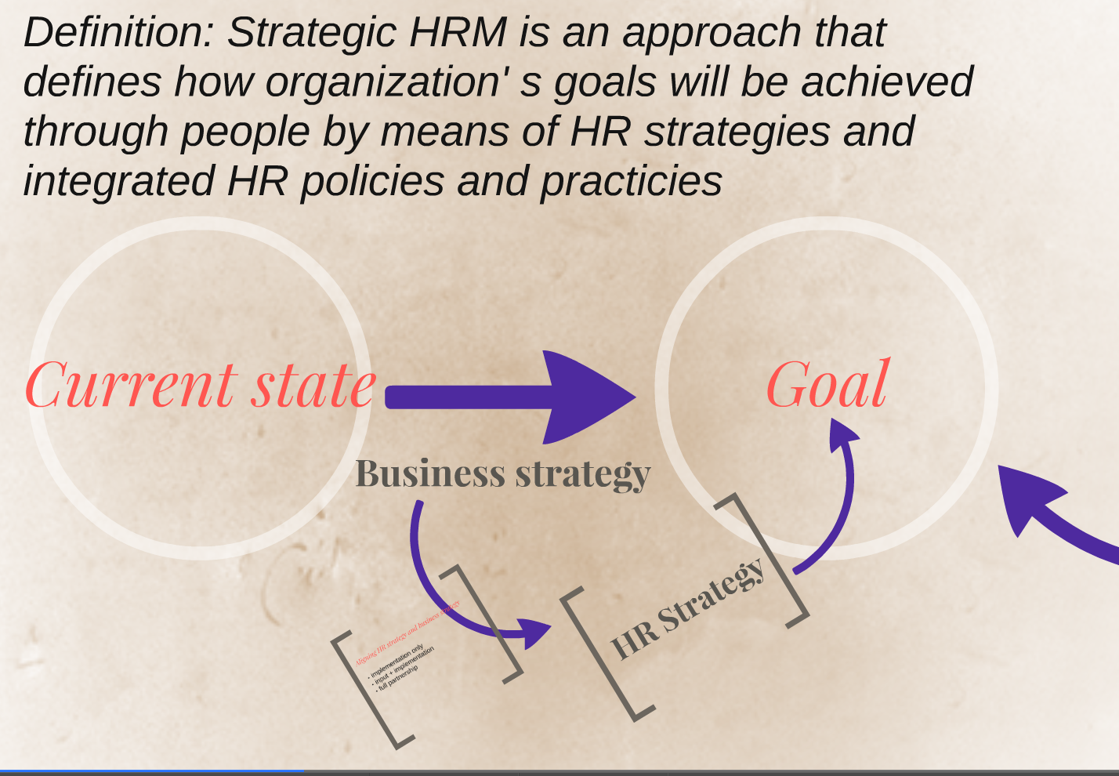
Notes:
Instructor notes:
A strong HR strategy is a multiplier of organisational success because it ensures:
the right people
with the right skills
in the right culture
working in the right structure
supported by the right systems to achieve the organisation’s goals.
Instructor closing line: “HR strategy is not separate from business strategy — it is business strategy, expressed through people.”

Slide 31
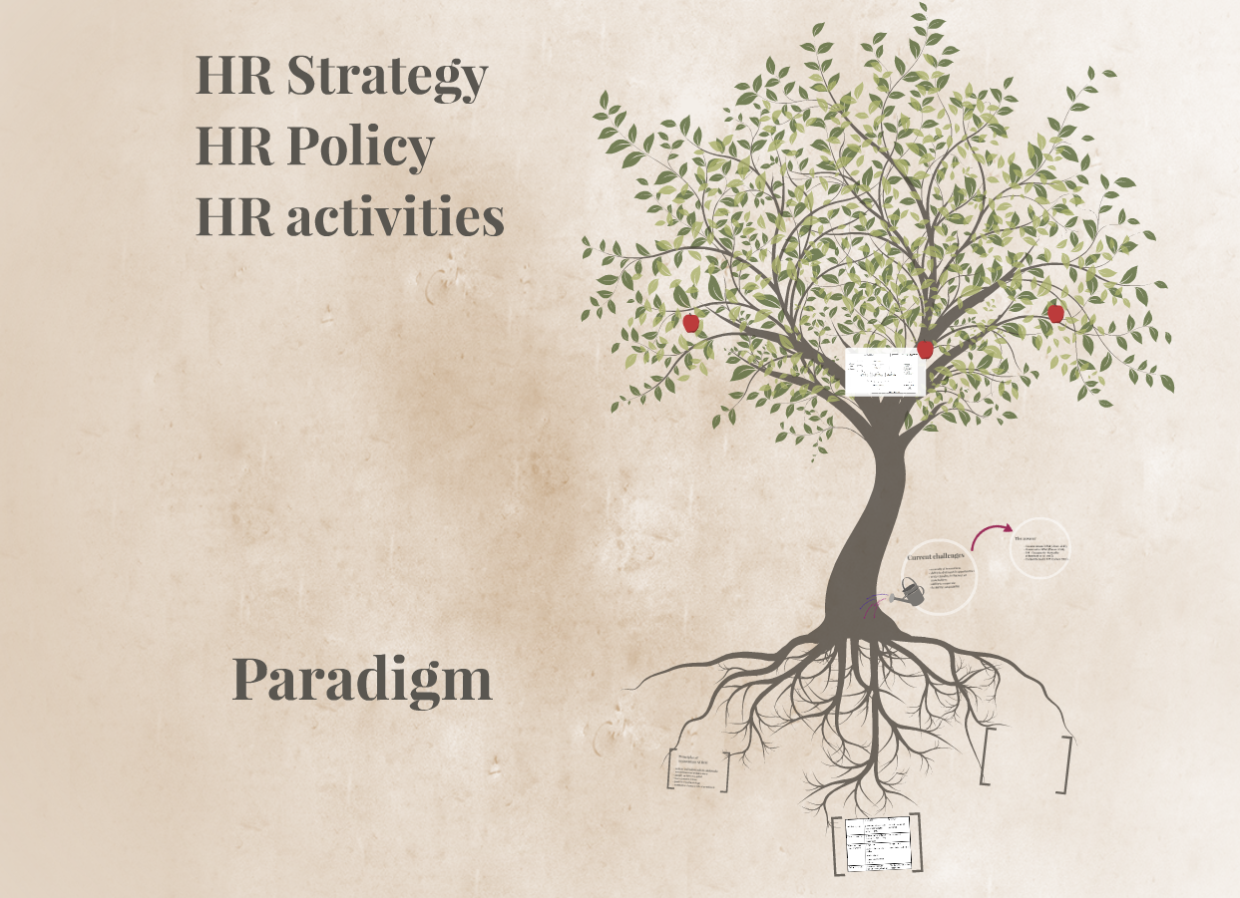
Notes:
Instructor notes
1. HR Strategy sets the direction
2. HR Policies translate strategy into rules and frameworks
3. HR Activities put policies into practice
4. All three must reinforce one another
5. Alignment prevents contradictions and confusion
6. Alignment increases organisational effectiveness

Slide 32
Changes in the context of the HR function - Social context
evolution in different generations – baby boomers, X, Y, Z
Focus on balanced personal life
Work loses its place as a central value in society
young people who are more individualistic (give-and-take relationship, desire for autonomy)
women more concerned about professional equality
seniors sometimes badly treated
the situation of executives (managers) weakened and deteriorated
weakened unions
stress and suffering at work
Notes:
Instructor Notes
Explain how generational diversity influences values and work expectations:
Baby boomers: loyalty, stability
Gen X: autonomy, balance
Gen Y/Millennials: purpose, flexibility
Gen Z: individuality, technology fluency
Discuss societal trends:
declining centrality of work
increased focus on equality and mental health
weakened traditional authority structures
rising stress despite technological progress
Highlight that HR must adapt to this fragmented landscape.

Slide 33
Changes in the context of the HR function – Economic context
increased competition => more acute imperatives of profitability
unfavorable demographics => labor shortage
new technologies => need for new skills
demand for a strong capacity for abstraction, know-how, sorting and prioritizing information, management capabilities
work in a network and/or in a project
omnipresent change
questioning of the profession
Notes:
Instructor Notes
Discuss global competition and its pressure for efficiency and innovation.
Explain demographic challenges: shrinking workforce, ageing population → talent shortage.
Highlight the shift toward knowledge work: abstraction, information processing, cross-functional collaboration.
Emphasize that continuous learning is essential—static skills quickly become obsolete.
Present project-based work as the new normal.

Slide 34
Current shift in paradigm
Before Today
Obedience responsibility
assigned tasks concrete goals
Silence communication
Execution initiatives proposal
Repetitive/routine adaptation/progress
hierarchical distance co-production of solutions
habituation training, professionalism
conflicting interests partnership initiation
by carrot and stick motivation release energies
Notes:
Instructor Notes
Contrast old vs. new management logic:
obedience → responsibility
silence → open communication
routine execution → initiative, innovation
hierarchy → co-creation
Connect to modern leadership: psychological safety, empowerment, collective intelligence.
Stress that employees expect involvement, not commands.

Slide 35
Embracing finitude
(Source: Oliver Burkeman: 4000 weeks)

Slide 36
Adopt fixed volume approach to productivity
Open vs. close to-do list
Pay yourself first
Notes:
Instructor Notes
Introduce Burkeman’s philosophy: We cannot do everything — so we must choose wisely.
Explain the dangers of an “open” to-do list: it expands infinitely.
Advocate for a “closed” list: a few commitments, executed fully.
This reduces anxiety and increases focus.

Slide 37
Serialise, serialise, serialise
One big project at a time
Shifting form project to project is one of the biggest time thief
Notes:
Instructor Notes
Explain that multitasking is a myth — people switch tasks rapidly, losing time and quality.
Promote handling one major project at a time where possible.
Share neuroscience findings: switching costs, reduced working memory, more errors.

Slide 38
Decide in advance what to fail at
Strategic underachievment
Deciding what is not important right now is as important as deciding what is important
Notes:
Instructor Notes
Introduce the concept: Some areas of life will get less attention—choose them deliberately.
Examples:
During a major work project, housework standards may drop.
During family priorities, work ambitions might pause.
This prevents guilt and supports strategic focus.
Emphasize that intentional neglect is not incompetence—it’s prioritisation.

Slide 39
Focus on what is already completed, not just on what is left to complete
Keep “done” list
Notes:
Instructor Notes
Explain negativity bias: our brains ignore progress and fixate on unfinished tasks.
A “done” list trains the brain to recognise achievement.
Increases motivation and perceived competence.

Slide 40
Consolidate your caring
Consciously pick your battle in charity, activism and politics
Notes:
Instructor Notes
Discuss compassion fatigue: caring about too many causes leads to burnout.
Encourage participants to choose specific areas where they invest energy — charity, activism, community.
Emphasize depth over breadth.

Slide 41
Embrace boring, single purpose technology
Like alarm clock or e-reader
Switch your mobile phone to the grayscale
Notes:
Instructor Notes
Make the case that smartphones fragment attention.
Suggest alternatives:
alarm clock instead of phone
e-reader instead of multitasking device
grayscale mode to reduce dopamine triggers
Explain that environment design often beats willpower

Slide 42
Sacrificy flexibility for rewards of community
We tent to see time as normal good – but is more network good
Notes:
Instructor Notes
Introduce the idea of time as a network good: its value increases when coordinated with others.
Examples: shared work rhythms, weekly team rituals, family routines.
Explain that too much individual flexibility can weaken community structures and cause isolation.
Emphasize commitment as a stabilising force.

Slide 43
Practice doing nothing
In Slovak “to focus” is translated as “súSTREDiť”
STRED=center
Sometimes we can find our center, ourselves, only when we remove the noise, the activity, the inner critic, the outer perrspective on ourselves
Notes:
Instructor Notes
Explain that stillness is a skill — essential for creativity and emotional regulation.
Connect to mindfulness and contemplative traditions.
Share the Slovak linguistic insight (“sústrediť” → “to center”) → you find your center when external noise quiets.
Encourage short “pauses” throughout the day to reset attention.

Slide 44
