Slide 1


Dynamic Integration Environment Introduction to European Integration Matej Bel University in Banská Bystrica, Slovakia
© 2025 by Ž. Lacová is licenced under CC BY

Slide 2
Overview
Historical Context of Economic Integration
Other Examples of Economic Integration: Regional Integration Agreements Wordlwide
Enlargement of the EU: Experience and Future Perspectives
Institutional Players and Decision-Making Process of the EU
Current Priorities of the EU

Slide 3
Defining integration
Process of removal of barriers among countries involved
Let´s discuss
Q1: What kind of barriers the countries can face to?
Q2: Do you know some examples of economic barriers companies can face in international trade?

Slide 4
Economic barriers = restrictions to trade
Tariffs
Quotas
Non-tariff barriers

Slide 5
Defining economic integration
The theory of economic integration studies how and at what cost countries
can pass from total protectionism
to a situation of free trade.
3 main dimensions:
Degree of integration
Geographical coverage
Range of effects (economies of scale, allocation of ressources, diversification, productivity of inputs, profit margins of firms etc.)

Slide 6
Degrees of international integration
Free Trade Area Removal of Internal Tariffs
Customs Union Common External Tariffs
Common Market Free Flow Capital and Labour
Economic and Monetary Union
Harmonize Economic Policy
Political Union Political integration

Slide 7
Let´s discuss
Q3: What are the reasons (favorable factors) which motivate countries to pass gradually from protectionism to free trade?
Q4: What are the cons (unfavorable factors) of such integration?

Slide 8
Pros of economic integration
Trade creation (resources allocated according to comparative advantage)
Trade diversion (only positive ?)
Reducing monopoly power
Reducing level of X-inefficiency – overmanning, excessive holding of stocks and other types of slack management practices
Economies of scale, Learning effects
Stregthened bargaining position with external partners

Slide 9
Opponents of economic integration
Integration hurts third countries
‘Spaghetti bowl’ of various principles
Regional industry-specific lobbies
Administrative costs
Trade wars among regional trading blocks
Increasing protection of business areas

Slide 10
Let´s discuss
Q5: What were the reasons which motivated countries
in Western Europe to integrate?

Slide 11
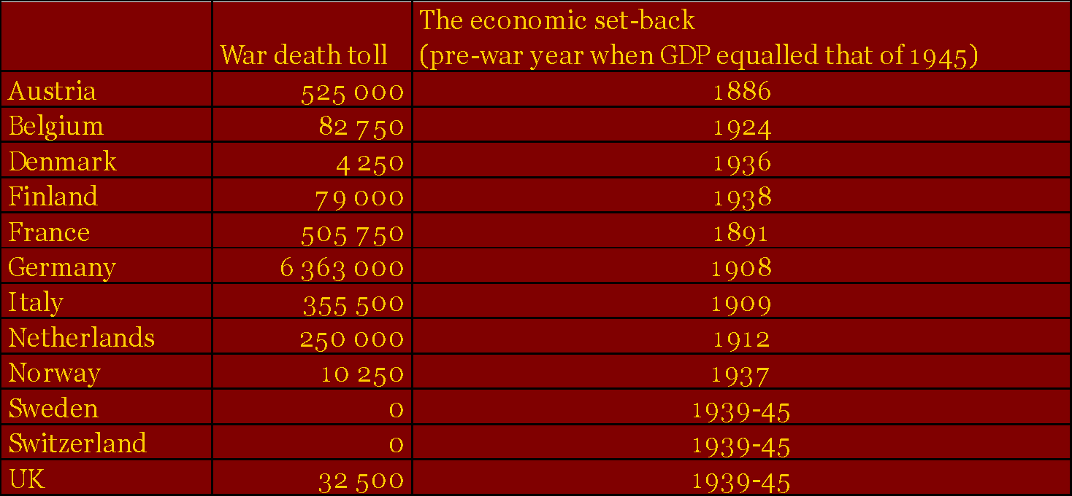
Political situation in Europe in early post-war period : a climate to radical change

Slide 12
Political situation in Europe in early post-war period
War toll, refugees, hunger :
How can Europe avoid another war?
Blaming loser = Germany
Blaming capitalism = the Cold War
Blaming nationalism = tighter integration of European nations

Slide 13
Let´s discuss
Q6: Listen and try to guess who made this speech.

Slide 14
Q7: Do you know these names? What do they have in common?
Konrad Adenauer | Winston Churchill |
Alcide De Gasperi | Walter Hallstein |
Jean Monnet | Robert Schuman |
Paul-Henri Spaak | Altiero Spinelli |

Slide 15
Two strands of European integration
Federalism
supranational organization
power to supranational institutions
( ECSC, EEC – customs union)
Intergovernmetalism
nation-states as the most effective and stable form of government
power keep in the hands of national officials
( EFTAssociation – free-trade area)

Slide 16
Q8 : What is a starting point of European integration ?
1949 : Council of Europe
1950 : Schuman Plan
1951 : European Coal and Steel Community (ECSC)
1957 : Treaty of Rome

Slide 17
Deepening of integration in Europe : Treaties
Treaty establishing the European Coal and Steel Community (ECSC) (1951, 1952, 2002- vypršala platnosť)
Treaties of Rome: EEC and Euratom (1957, 1958)
Merger Treaty – Brussel Treaty (1965, 1967)
Single European Act (1986,1987)
Maastricht Treaty (1992, 1993)
Treaty of Amsterdam (1997, 1999)
Treaty of Nice (2001, 2003)
Treaty of Lisbon (2007, 2009)
Founding agreements | European Union (europa.eu)
Q9: Since when we talk about „European Union“ ?

Slide 18
Degrees of economic integration in the EU
Free Trade Area
Customs Union (1968)
Common Market (1993)
Economic and Monetary Union (1999)
Political Union?

Slide 19
European Enlargement
1958: Founding Members: BE,FR,DE,IT,LU,NL
1973: 1st wave: DK, IE, UK
1981: Southern wave 1: GR
1986: Southern wave 2: PT, ES
1995: 4th wave: AT, FI, SE
2004: 5th wave 1: CZ, EE, CY, LV, LT, HU, MT, PO, SK, SI
2007: 5th wave 2: RO, BG
2013: HR
2020: - UK (Brexit)

Slide 20
Next Enlargement
Current candidate countries are:
Albania (AL)
Moldova (MD)
Montenegro (ME)
North Macedonia (MK)
Serbia (RS)
Türkiye (TR)
Ukraine (UA)
Bosnia and Herzegovina (BA), Georgia (GE) and Kosovo (XK) are potential candidates.
Q10: What criteria needs a country to meet in order to join the EU ?

Slide 21
Economic integration worldwide
Regional Integration Agreements (Venables,2000):
= groupings of countries formed with the objective of reducing barriers to trade between members of the group
WTO : 170 RIAs notified + 70 operational but not notified
Q11: Can you find some examples of RIA in Europe, Asia, America, Australia, Africa ?

Slide 22
EUROPE
European Union
European Free Trade Association
Central European Free Trade Agreement
Council for Mutual Economic Assistance

Slide 23
AMERICA
North American Free Trade Agreement
The U.S.-Mexico-Canada Agreement (USMCA)
Latin American Free Trade Area/
Latin American Integration Association
Andean Pact
MERCOSUR
Central American Common Market
Free Trade Area of the Americans

Slide 24
ASIA and THE PACIFIC
Asia Pacific Economic Cooperation
Association of South-East Asian Nations
ASEAN-China Free Trade Area
Closer Economic Relations between Australia and New Zealand
The Arab League

Slide 25
AFRICA
East African Community
Central African Customs and Economic Union
Economic Community of West African States
South African Customs Union
Southern African Development Community
Common Market for Eastern and Southern Africa
Organisation of African Unity

Slide 26
Economic integration worldwide
No other RIAs succeed to deepen its integration than the European Union
European Union – an example for the others RIAs, the most integrated form of the market integration worldwide
European project is today deeper and wider than was ever imagined in its early days, and remains truly unique in the world.
Periods of cyclic euro-optimism and euro-pessimism

Slide 27
Defining the EU
EU = a federation like USA?
EU = organization for co-operation between governments like United Nations ?
EU as a unique international organization which offers a set of common supranational institutions established by the member states
Each member state gives up some of its sovereignty, in order to make decisions important on a European level. This combining of sovereignty is often defined as "European integration„.

Slide 28
Institutional framework of the EU
There are 4 main decision-making institutions which lead the EU’s administration. These institutions collectively provide the EU with policy direction and play different roles in the law-making process:
the European Parliament (Brussels/Strasbourg/Luxembourg)
the European Council (Brussels) – Heads of State
the Council of the European Union (Brussels/Luxembourg)
the European Commission (Brussels/Luxembourg/Representations across the EU)
Q12: What kind of interest do the institutions represent ?
EU institutions and bodies – functions | European Union (europa.eu)

Slide 29
Current European Priorities
When preparing the visions for your plans, try to contribute to the EU priorities....
EU strategic agenda for 2024-2029
Priorities of the European Commission 2024-2029
European Union priorities 2024-2029 - European Union

Slide 30

Thank you.
zaneta.lacova@umb.sk

